Slide 1

THE ELECTRIC EDGE IN URBAN
AND INNER-CITY DELIVERY

Slide 2
Access the last mile with powerful,
all-electric cooling for battery-powered
light commercial vehicles

Slide 3
Contents
Energy
efficiency
Fully electric operations
Versatile
installation
Unmatched cooling capacity
Daily savings

Slide 4
Energy Efficiency

Slide 5
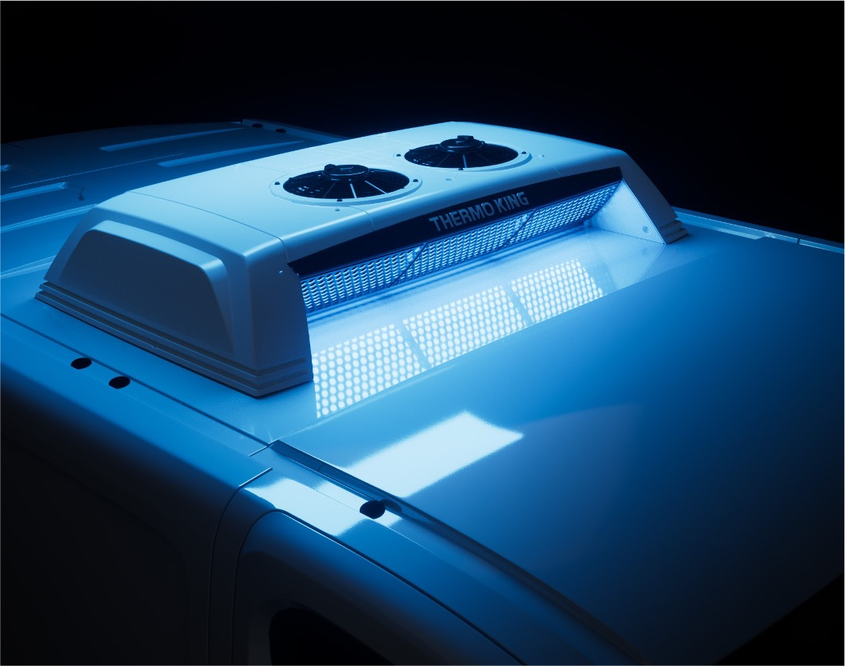
Minimal impact on vehicle battery. Maximal BEV autonomy.
HIGHLY ENERGY EFFICIENT
Maximize fleet independence to roam further
Longer, more diverse delivery routes

Slide 6
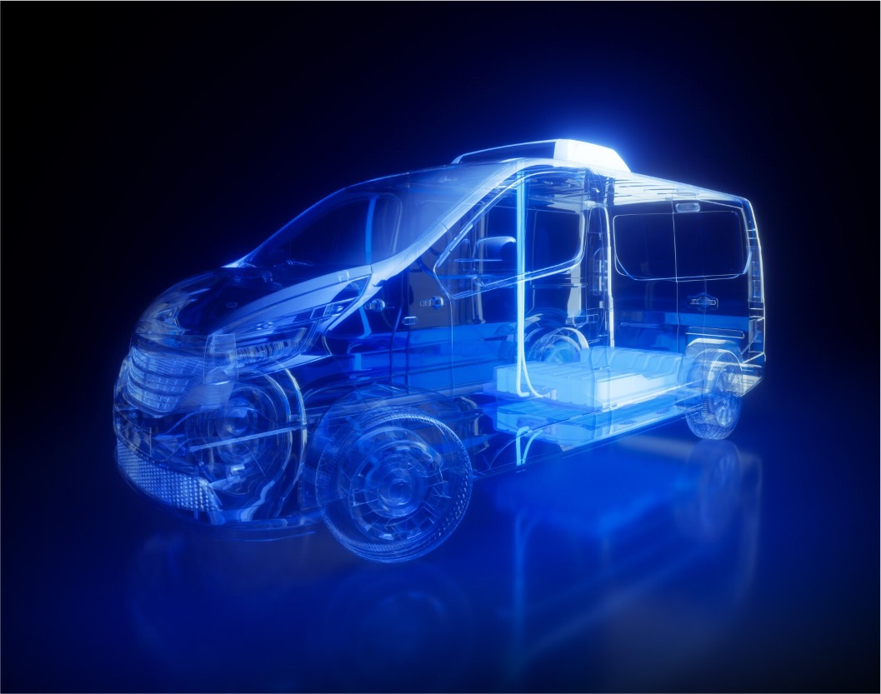
Seamless connection between vehicle and unit perfect cooperation.
HIGHLY ENERGY EFFICIENT
Custom-designed inverter
Real-time communication and data exchange

Slide 7

Fully electric operations

Slide 8
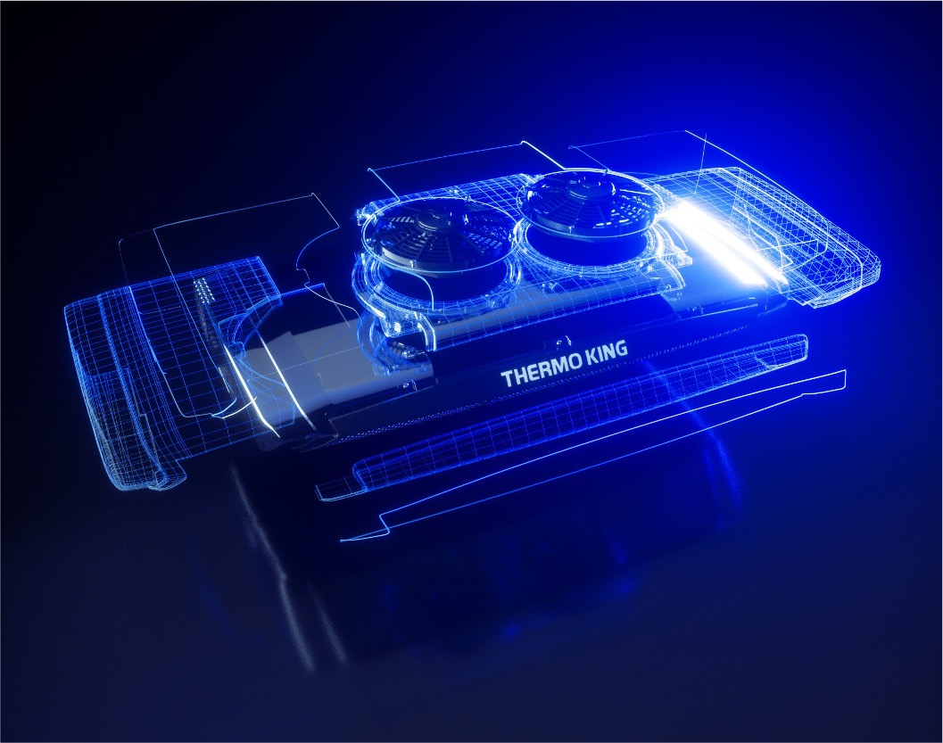
Powered directly from your vehicle battery.
FULLY ELECTRIC OPERATIONS
Zero-emission, all-electric cooling
No additional battery pack
No shore connection module

Slide 9
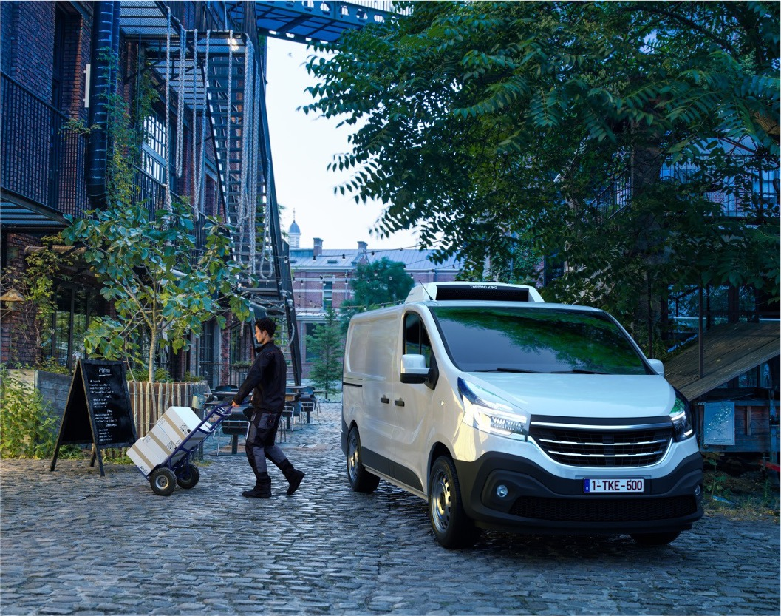
Smart electric power take-off.
FULLY ELECTRIC OPERATIONS
Keep cooling unit running and cargo protected during delivery stops or vehicle charging.*
*dependent on e-vehicle type

Slide 10
Operational flexibility.
FULLY ELECTRIC OPERATIONS
Complete compliance with urban and inner-city regulations.
Day or night
Low Emission Zones (LEZ), Ultra Low Emission Zones (ULEZ) and Zero emission zones ZEZ access

Slide 11
Versatile installation

Slide 12
VERSATILE INSTALLATION
NOSE
ROOF
POD
TWO MODELS. THREE MOUNTING OPTIONS..
.

Slide 13
Unmatched cooling capacity

Slide 14
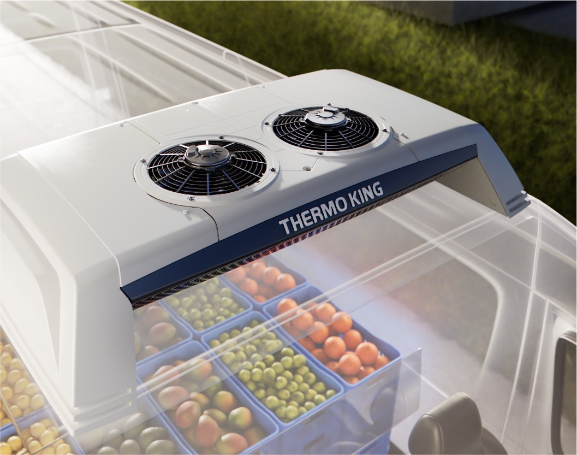
Constant, high-capacity cooling.
UNMATCHED COOLING CAPACITY
High-speed compressor
RPM independent of vehicle speed

Slide 15
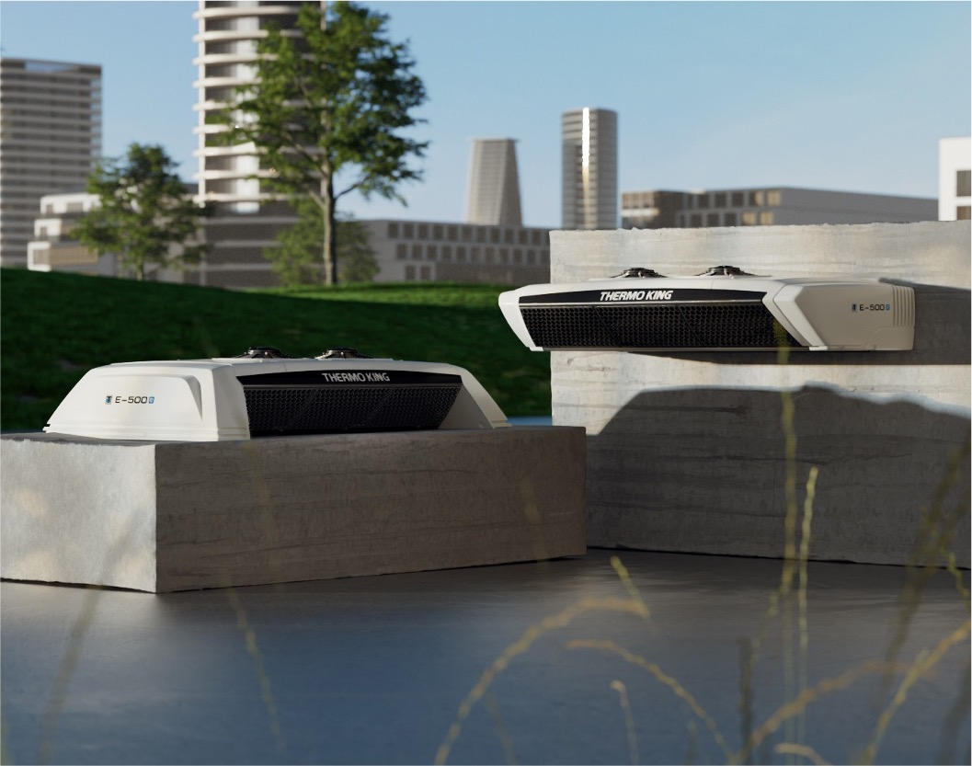
Multi-temperature capacities with E-600-e.
UNMATCHED COOLING CAPACITY
With an extra evaporator E-500e becomes a multi-temp unit
2 possible evaporator configurations: ES150 + ES300 or ES300 + ES300

Slide 16
Daily savings

Slide 17
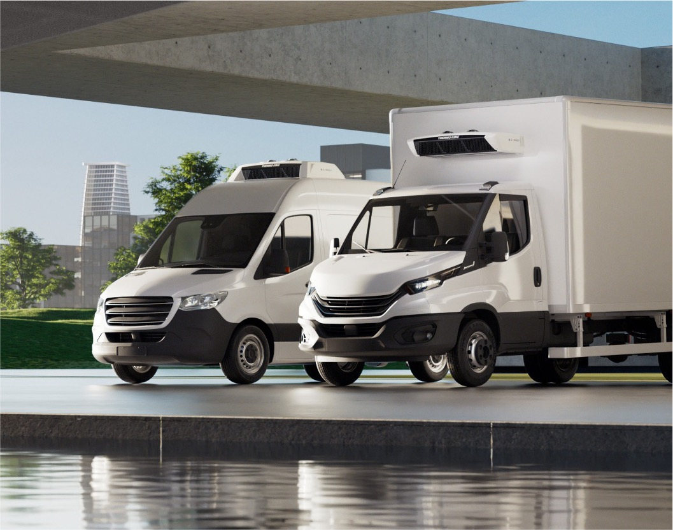
Compact design. High payloads.
DAILY SAVINGS
50% lighter than legacy models
More cargo space in each delivery cycle

Slide 18
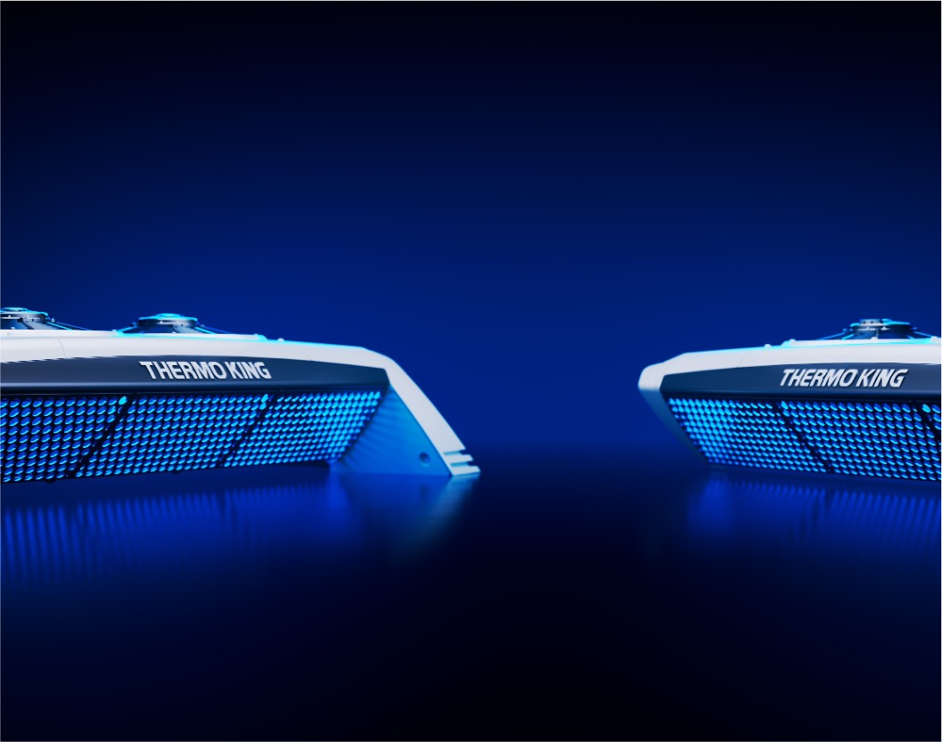
Lowest TCO.
DAILY SAVINGS
Leaner design means:
Less maintenance
Higher resale value

Slide 19

Giving your fleet the Electric Edge
IN URBAN AND INNER-CITY DELIVERY

Slide 20
THANK YOU

