Slide 1
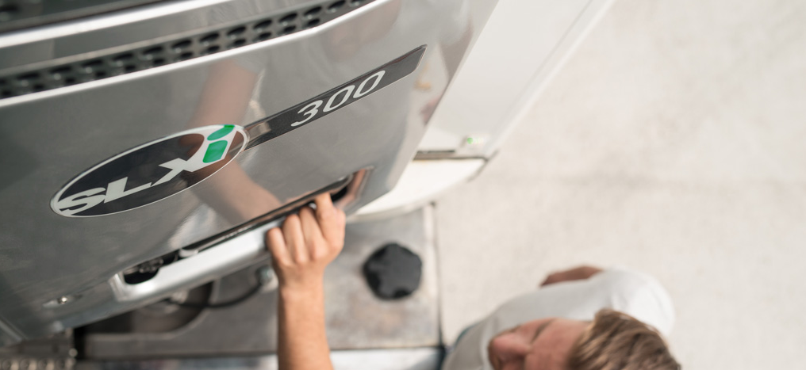


SLXi – SINGLE AND MULTI-TEMPERATURE REFRIGERATION FOR TRAILERS
You win. Always.
Version 5.0
2019 MODEL – NRMM STAGE V CERTIFIED

Slide 2

TABLE OF CONTENTS
SLXi – THE UNIT OF CHOICE
SLXi – INTELLIGENCE AND 24/7 CONNECTIVITY AS STANDARD
SLXi – FUEL SAVING WITH PRECISE TEMPERATURE CONTROL
SLXi – Minimizing your Total Cost of Ownership
SLXi – Quality you can depend on
SLXi – Helping you care for our planet
SR-3 controller – putting you in control
SLXi – Whisper quiet operation for total urban access
SLXi – Fully GDP-compliant pharmaceutical transport
SLXi – Tune your unit to your needs: OPTIONS & ACCESSOIRES
SLXi – Specifications
SLXi – MULTI-TEMPERATURE CONFIGURATIONS
THERMO KING’S DEALER SERVICE NETWORK

Slide 3


SLXi – THE UNIT OF CHOICE
INTRODUCING SLXi
Be in control of your choices.
SLXi means: empowerment and capability.
Meet customers’ demands for ultra-fresh produce
Products are delivered to ultra-tight schedules while limiting overall costs.
Upsize your performance and downsize your operating costs.
Europe’s first NRMM Stage V compliant trailer unit
In short: with SLXi, you win. Always.

Slide 4
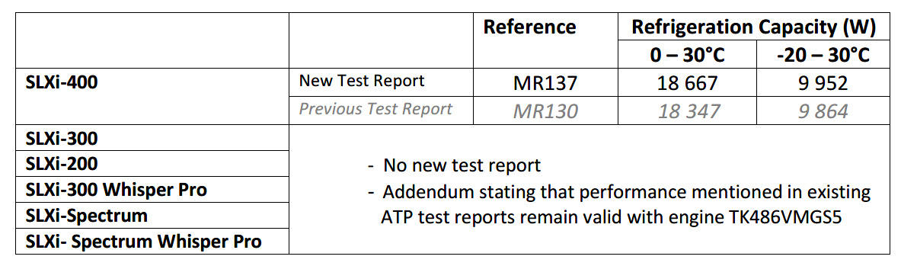
SLXi – THE UNIT OF CHOICE
SLXi, Europe’s first NRMM STAGE V compliant trailer unit
SLXi Range NRMM Stage V compliant – All models integrate NRMM Stage V certified engine since December 2018
Meeting the latest and toughest environmental standards
Same market leading performance, all fully ATP documented
The NRMM (The Non-Road Mobile Machinery) Regulation defines emission limits for NRMM engines for different power ranges and applications. It also lays down the procedures engine manufacturers have to follow in order to obtain type-approval of their engines – which is a prerequisite for placing their engines on the EU market.
In short: with SLXi, you continue to win. Always.

Slide 5
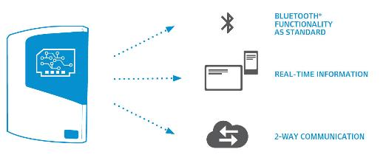

SLXi – THE UNIT OF CHOICE
I CONNECT. I WIN.
SLXi the first fully “telematics ready” unit
TK BlueBox communication device on every unit
Proactively manage your fleet thanks to a critical flow of data
Maximize up time and improve efficiency
With SLXi, you have the power of connection.

Slide 6
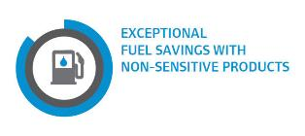



SLXi – THE UNIT OF CHOICE
I CHOOSE. I WIN.
Fuel typically represents more than half of your Total Cost of Ownership.
Get a fuel cost reduction up to 20%
Choose the best balance between exceptionally precise temperature control and market-leading fuel economy
Match unit performance exactly to the particular requirements of the load
Select your best option from an extensive range of single and multi-temperature units
Choose from performance-enhancing options
SLXi enables you to cut fuel costs dramatically.

Slide 7

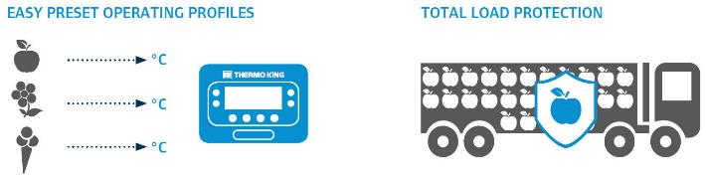
SLXi – THE UNIT OF CHOICE
I CONTROL. I WIN.
SLXi puts fleet managers and drivers in full control of their units and cargo.
Total ease of operation + selection of pre-set operating profiles:
eliminates costly errors and maximises return on investment
Customisable operating parameters:
ensure maximum economy and total load protection
Now you can choose the ideal profile for your operation.

Slide 8
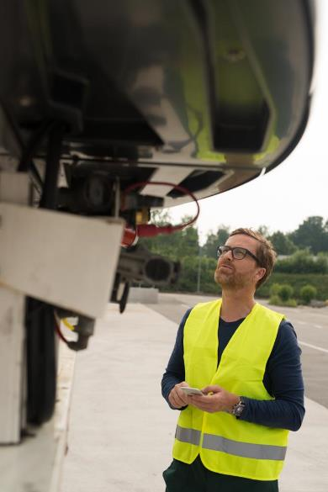

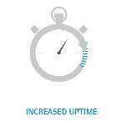
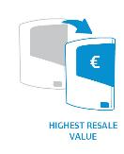
SLXi – THE UNIT OF CHOICE
I TRUST. I WIN.
With its 80 years of experience, Thermo King, is the industry leader in dependability.
Refined design
reduces the stress on key components
extends unit life
cuts maintenance costs
system is fully optimized
Exhaustive laboratory testing + one of the largest field trials ever undertaken
enjoy total peace of mind
rely on a unit with best in class quality, reliability and support
You can trust us to deliver to the highest standards.

Slide 9

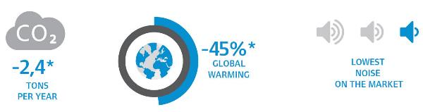
SLXi – THE UNIT OF CHOICE
I CARE. I WIN.
SLXi is the greenest unit in its class.
It cuts global warming impact by 45% and CO2 by 15%.
Lowest energy consumption
Smallest carbon footprint
Least global warming rate potential
Quietest operating sound levels
Choosing the SLXi shows you care.

Slide 10


SLXi – THE UNIT OF CHOICE
You win. Always.

Slide 11
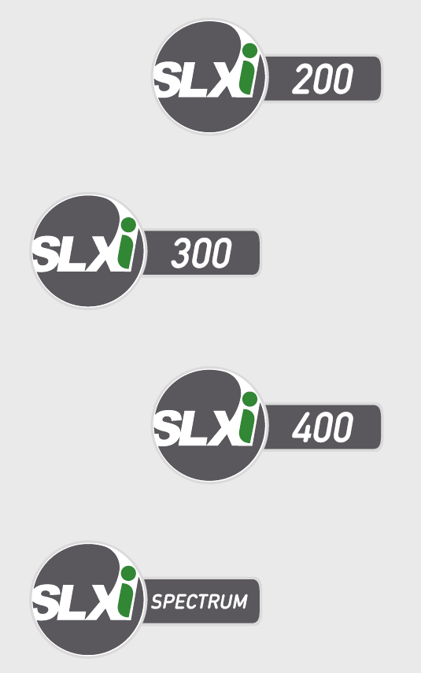
SLXi – THE UNIT OF CHOICE
SLXi PRODUCT RANGE.
The SLXi is offered as an extensive range of single and multi-temperature units, customized with performance-enhancing options, to give you precisely the capabilities you need for your business.
Optional for all standard models
Available for SLXi-300 and SLXi Spectrum models
PIEK Certified Sound Level

Slide 12
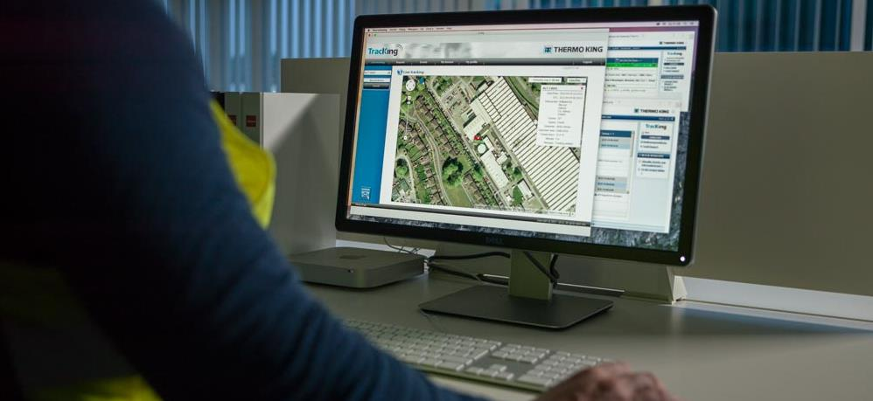
SLXi – INTELLIGENCE AND 24/7 CONNECTIVITY AS STANDARD
You win. Always.

Slide 13
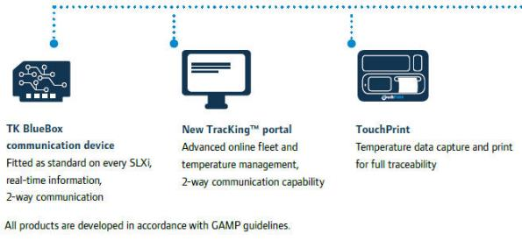
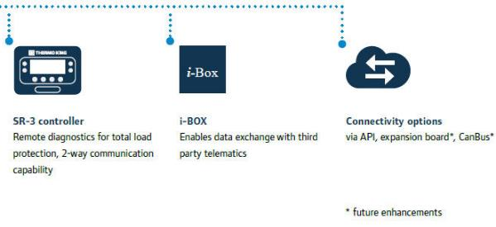
SLXi – INTELLIGENCE AND 24/7 CONNECTIVITY AS STANDARD
TOTAL CONNECTIVITY WITH THE NEW TK BLUEBOX COMMUNICATION DEVICE INCLUDING BLUETOOTH®.
EVERY SLXi comes with TK BlueBox communication device and Bluetooth® as standard.
SLXi is the industry’s first fully telematics-enabled unit
Total connectivity → proactively manage your fleet

Slide 14
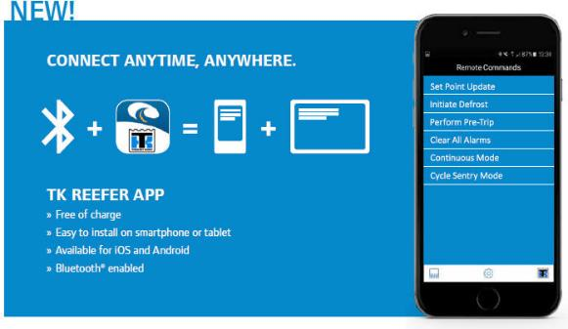
SLXi – INTELLIGENCE AND 24/7 CONNECTIVITY AS STANDARD
TOTAL CONNECTIVITY WITH THE NEW TK BLUEBOX COMMUNICATION DEVICE INCLUDING BLUETOOTH®.
Bluetooth® enabled
communicate free of charge with your smartphone or tablet
Easily installed on iOS or Android devices.
Cellular service is available with subscription
Real-time information to view and monitor:
set point, return air and discharge air
door status
fuel status
alarm status
operating mode
Dealer locations and contact information

Slide 15
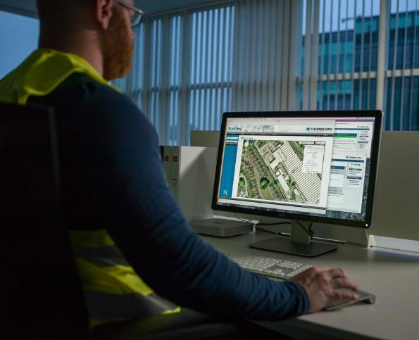
SLXi – INTELLIGENCE AND 24/7 CONNECTIVITY AS STANDARD
TOTAL CONNECTIVITY WITH THE NEW TK BLUEBOX COMMUNICATION DEVICE INCLUDING BLUETOOTH®.
EVERY SLXi has 2-way communication capability.
Connect and manage your unit wherever you are
Be in control remotely:
start or stop the unit
change the temperature set point
initiate defrost
perform a pre-trip inspection
clear alarms
change the operating mode continuous run/cycle sentry

Slide 16
SLXi – FUEL SAVING WITH PRECISE TEMPERATURE CONTROL
FUEL SAVINGS WITH PRECISE TEMPERATURE CONTROL.
Specific choice of profiles:
accurate temperature control for highly sensitive loads
substantially reduced fuel consumption for less sensitive cargoes
SR-3 controller with OptiSet™ Plus customizable operating parameters
best setup for your particular needs – virtually eliminates the risk of operator error
For Fuel economy:
a 27% larger condenser coil reduces engine speeds
cuts fuel consumption
maintains/increases capacity and airflow
For Precision Temperature Control (PTC):
Electronic Throttling Valve (ETV) technology* * SLXi-300, SLXi-400 and SLXi Spectrum
high frequency liquid line solenoid valve pulsing
rapid pull-down for temperature recovery with smooth temperature control

Slide 17
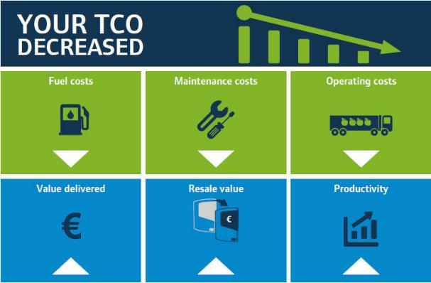
SLXi – Minimizing your Total Cost of Ownership
THE IMPORTANCE OF THE TOTAL COST OF OWNERSHIP.
Total Cost of Ownership (TCO) = return on investment
Fuel typically comprises more than 50% of the TCO over a 7 year first life.
substantial savings of 10-20%* on average when compared with its already impressive predecessor. *Depending on operating profiles
Maintenance costs are managed downwards and made predictable by choosing the right service contract →ThermoKare
Operating costs are reduced by the careful selection of the right operating profile for each load

Slide 18
SLXi – Minimizing your Total Cost of Ownership
THE IMPORTANCE OF THE TOTAL COST OF OWNERSHIP.
Purchase price
covers service support, quality, reliability, innovation, dependability and much more.
Legendary Resale value of equipment
Productivity gains with fleet management tools, such as TK BlueBox telematics connectivity, now standard on all SLXi units

Slide 19

SLXi – Quality you can depend on
Enjoy total peace of mind thanks to:
Global field trial and exhaustive laboratory testing
27% larger condenser permits reduced engine speeds and minimizes component stress
Exceptional component durability, that gives increased uptime and lower maintenance costs
E-coated frame, that provides lifetime corrosion protection
World leading Dealer network, that guarantees an expert and supportive partner, round the clock
IF I CAN TRUST THE UNIT AND THE SUPPORT, I WIN.

Slide 20

SLXi – Helping you care for our planet
You win. Always.

Slide 21
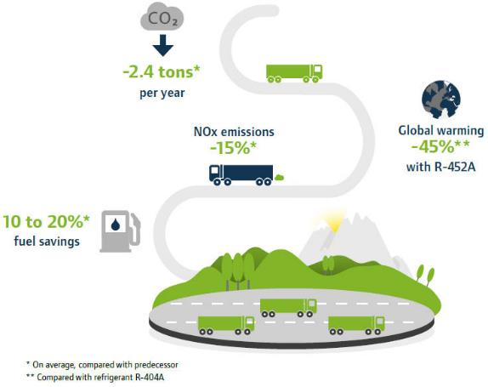
SLXi – Helping you care for our planet
SUSTAINABILITY IS ONE OF OUR CORE VALUES.
The reduction of environmental impact can take many forms including:
Reduction of emissions (exhaust, CO2, noise).
Reduction of consumption (energy, carbon fuels).
Reduction of waste (land-fill, water usage, operational inefficiencies).
Thermo King has always taken a leadership position when it comes to sustainability.
Ingersoll Rand made a public commitment in September 2014 to reduce operational greenhouse gas (GHG) emissions by 35% and productrelated GHG by 50% by the year 2020.

Slide 22
SLXi – Helping you care for our planet
REDUCE YOUR ENVIRONMENTAL FOOTPRINT WITH SLXi.
SLXi is the market’s greenest diesel trailer unit.
Micro-channel heat exchangers technology reducing refrigerant charge and minimising the risk of leakage
A direct injection industrial grade engine operating at reduced RPM nominal speed provides clean, dependable
The SLXi is built in the world-renowned Thermo King Ireland plant following ISO 14000 and 18001 certified manufacturing process and achieving zero landfill

Slide 23
SR-3 controller – putting you in control
THE KEY TO TOTAL TEMPERATURE MANAGEMENT.
A simple, intuitive display with a choice of 23 languages has multiple functions, including:
Changing temperature set point
Setting selectable alarms and menus
Monitoring system performance
Initiating a start of trip
Recording all operational parameters
Simultaneous zone monitoring on multi-temperature applications
Checking fuel level* *If fuel level sensor fitted
Downloading CargoWatch™ data and uploading software updates via USB port
John Collins, driver delivers pharmaceuticals

Slide 24
SR-3 controller – putting you in control
THE KEY TO TOTAL TEMPERATURE MANAGEMENT.
Load protection is ensured by a range of features, including:
Keypad with lockout
Mode-lock
Phase correction
Diesel/electric auto switching
Set point warning
Wintrac™ software for data storage and analysis
Top freeze protection
Advanced system monitoring and alarm notifications
Precision Temperature Control (PTC) feature on multi-temperature units
Full suite of data recording, management and analysis tools

Slide 25
SR-3 controller – putting you in control
CARGOWATCH™
WINTRAC™
The SLXi comes with an on-board high-performance data logger data logger, as standard.
To ensure your full EU compliance, CargoWatch™ is a fully approved independent logger with the following options:
Six temperature sensors
Four door switches
Humidity sensor
Data averaging
Programmable out-of-range alarms.
Easy-to-use Windows® based reporting package
Simple, rapid data downloads, data search and generation of fully customizable reports in graphic or tabular format
OPTISET™ PLUS**
Pre-set operating parameters are tailored to match unit performance to the precise and unique requirements of each load
This provides operating economy and load protection, while dramatically reducing the risk of operator error
**On single temperature models only

Slide 26

SR-3 controller – putting you in control
GREATLY EXTENDED COMMUNICATION CAPABILITIES
SERVICEWATCH™
The SR-3 controller is designed to support high-speed, flexible communication tasks and offers:
Cable connection: when using a laptop with Wintrac™ software
USB key: via the USB port provided as standard, eliminating the need for laptops and cables
GPRS connection: via TracKing™ tool which allows online fleet and temperature management
Wireless communication: for simple and effective means of accessing critical data
Enables faster and more accurate fault diagnosis
Reduces downtime and labour hours
Keeps a record of system operating modes and performance characteristics.

Slide 27
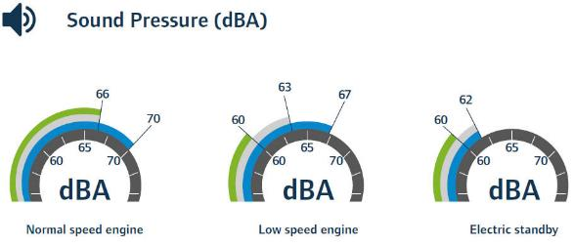

SLXi – Whisper quiet operation for total urban access
PUT AN END TO NOISE POLLUTION.
With the SLXi range, we are offering different levels of noise treatment:
The standard SLXi unit, best in class for quiet operation thanks to noise-reduced components, low engine speeds and extensive noise containment measures within the unit design.
An optional upgrade with the Whisper™ noise attenuating kit, available for most models and delivering a reduction in sound levels.

Slide 28


SLXi – Whisper quiet operation for total urban access
PUT AN END TO NOISE POLLUTION.
A top-of-the-range PIEK certified Whisper™ Pro version, available for the SLXi-300 and SLXi Spectrum (multi-temperature) models, which:
Complies with the most stringent noise abatement standards
Requires no manual intervention to activate or deactivate PIEK mode
Involves no additional installation or service costs being a one-piece nose-mount unit and
Features a dedicated controller which monitors the time and GPS position to force the unit into PIEK mode

Slide 29



SLXi – Fully GDP-compliant pharmaceutical transport
FULLY GDP-COMPLIANT PHARMACEUTICAL TRANSPORT
TK PharmaSolutions: a platform of applications and services that addresses the precise needs of the pharmaceutical industry.
Thermo King developed a Good Distribution Practice (GDP) protocol,
To follow EU guidelines to cover design, installation, operation and performance qualification
Real-time tracking and remote monitoring system TracKing™
enables detection of temperature deviations
immediate action to secure the load
TracKing™ is now GAMP5 validated
PharmaAssist service contract helps the customer to better manage risk throughout the life of the equipment
services include annual calibration, preventative maintenance, priority breakdown assistance and access to the iKare portal for full documentation.

Slide 30
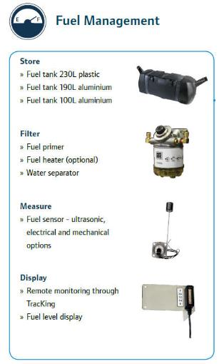
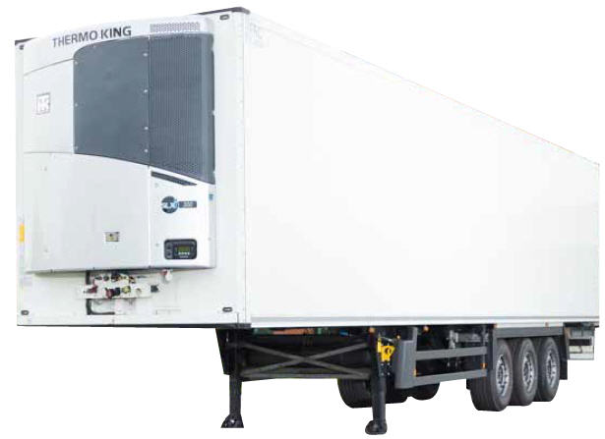
SLXi – Tune your unit to your needs

Slide 31
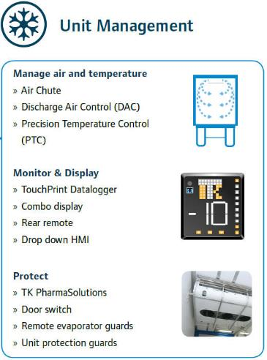
SLXi – Tune your unit to your needs

Slide 32
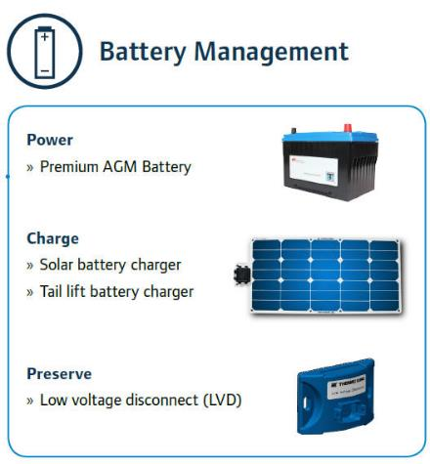
SLXi – Tune your unit to your needs

Slide 33
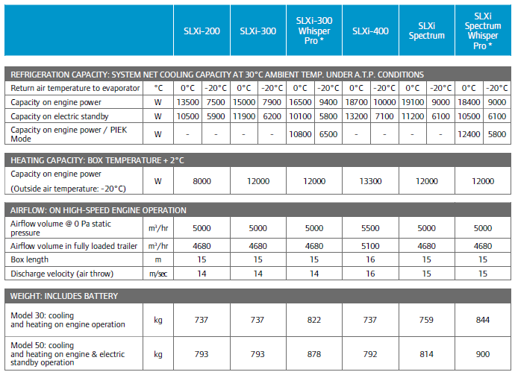
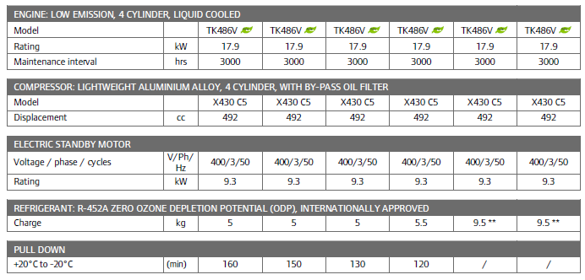
SLXi – Specifications

Slide 34
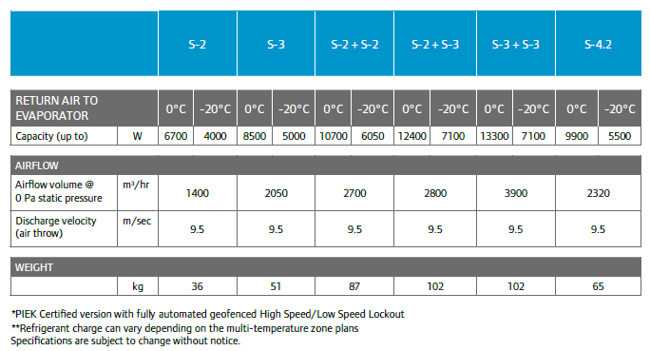
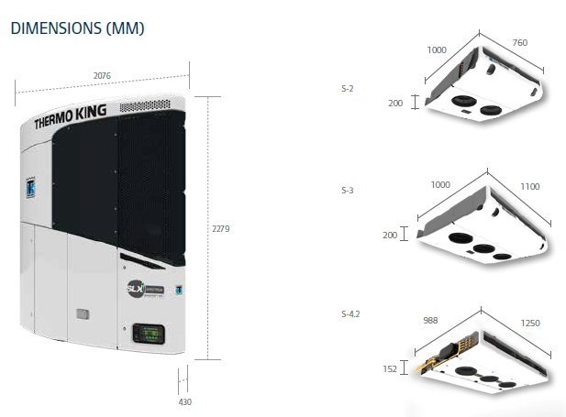

SLXi – Specifications
WARRANTY CONDITIONS
Thermo King warrants the new product delivered will be free
of defects in material and workmanship for the period of time specified
in the applicable warranties. Specific terms of the Thermo King warranty
are available on request.

Slide 35
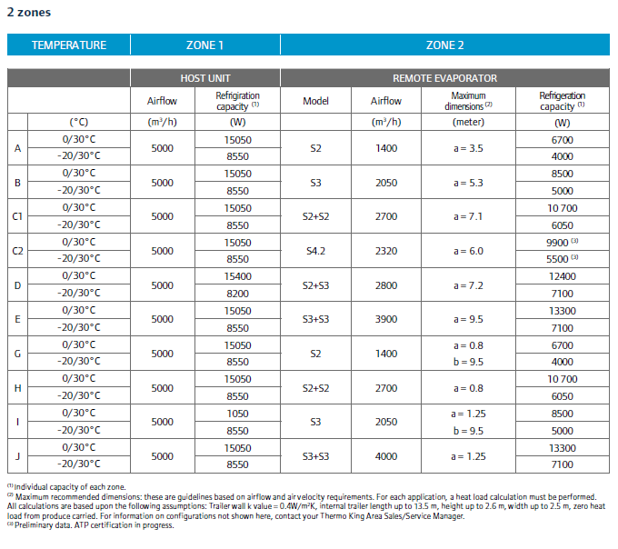
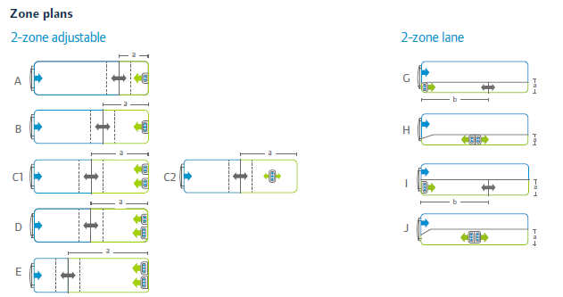
SLXi – MULTI-TEMPERATURE ZONES

Slide 36
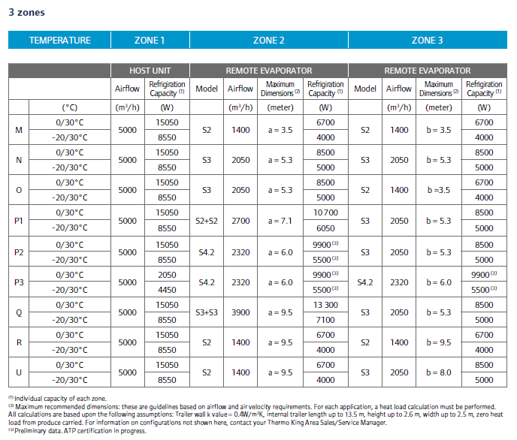
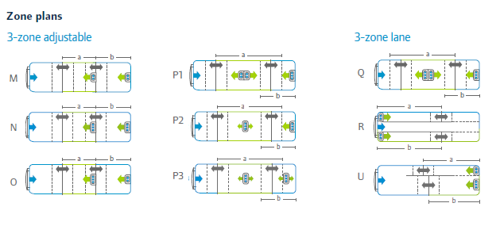
SLXi – MULTI-TEMPERATURE ZONES

Slide 37


THERMO KING’S DEALER SERVICE NETWORK
OUR DEALER SERVICE NETWORK
ANYTIME, ANYWHERE, ALWAYS THERE
Thermo King‘s Dealer Network is the most extensive in the business:
Over 500 authorized service points in 75 countries
1400 fully trained and certified technicians with Gold, Silver and Bronze Certi-Tech expertise certifications
Open and available 24/7
Other services include:
Emergency assistance
Service contracts
Genuine Thermo King parts
Options and Accessories
Mobile service
Calibration and leak testing
And much more!
Find the dealer closest to you
with our online dealer locator
dealers.thermoking.com

Slide 38

We appreciate comments, feedback, and any material useful to enrich our presentation.
E-mail us at:
marketing.europe@thermoking.com

