Slide 1


C-Series: reliable protection for fresh and frozen cargo
SINGLE TEMPERATURE REFRIGERATION SOLUTIONS
FOR SMALL, MEDIUM, AND LARGE TRUCKS & VANS

Slide 2
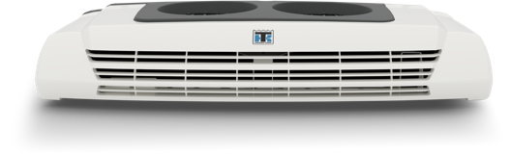
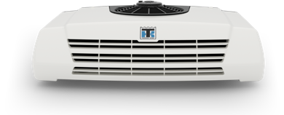
TABLE OF CONTENTS
For small, medium, and large vehicles
Extended product range

Slide 3

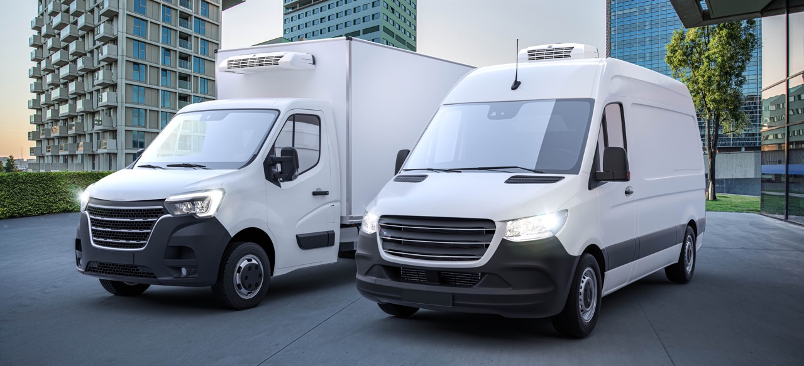
C-Series: FOR SMALL, MEDIUM, AND LARGE VEHICLES
Ideal for delivering temperature-sensitive cargo in vehicles up to 52M³
Perfectly suited for rigorous for multi-drop distribution runs
Reliable even in extreme high and low ambient temperatures
Protects cargo with fast temperature pull-down
Effortless operation thanks to the user-friendly in-cab controller

Slide 4
C-Series: FOR SMALL, MEDIUM, AND LARGE VEHICLES
Designed for higher performance
Quicker temperature pull-down
Higher airflow
Larger condensing capacity
Lightweight and compact design
Reduced refrigerant charge
Increased efficiency and sustainability
Optimized heating performance
Suitable for extreme ambient conditions
2-year warranty (unit and parts)

Slide 5
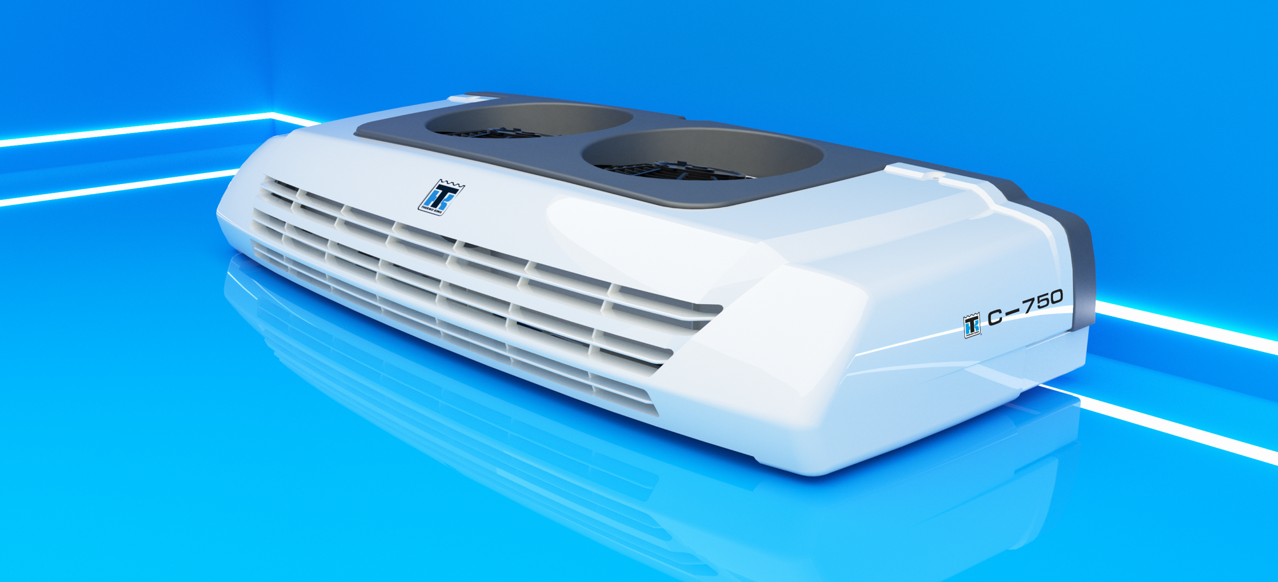
EXTENDED PRODUCT RANGE
Small, medium, and large trucks
Efficient and compact refrigeration units
Models to suit your needs:
  No defrost models
  Heating and cooling models
  Cooling only models

Slide 6

EXTENDED PRODUCT RANGE
Large trucks
Single-temperature control solutions for trucks up to 52M³
New C-550, C-650, and C-750 models
High condensing capacity thanks to two condensing fans
Aluminum microchannel heat exchanger to reduce weight and refrigerant charge
Robust control board

Slide 7

EXTENDED PRODUCT RANGE
Powerful road compressor
Widely available drive kits
Proven reliability and robustness
User-friendly controller
Intuitive design for easy use
Microprocessor intelligence
Display protected against moisture

Slide 8
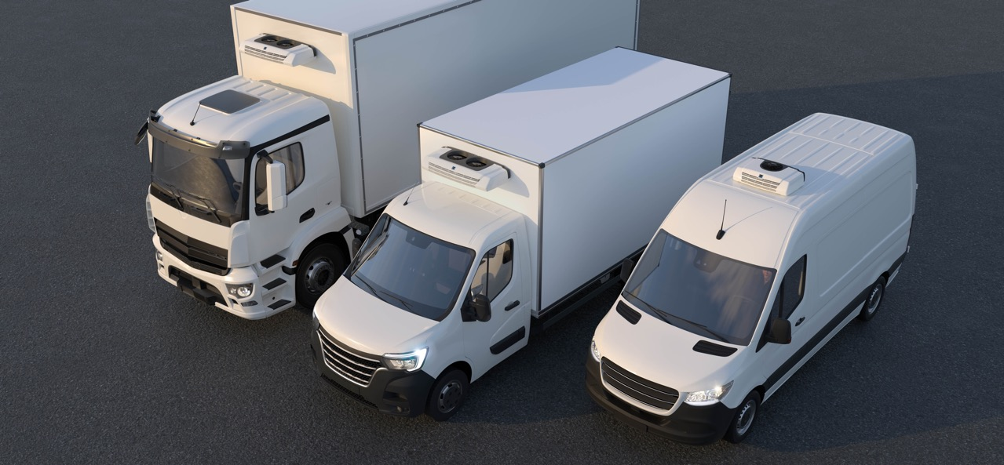
THANK YOU FOR YOUR ATTENTION!
C-SERIES
SINGLE TEMPERATURE REFRIGERATION SOLUTIONS
FOR SMALL, MEDIUM, AND LARGE TRUCKS & VANS

Slide 9

We appreciate comments , feedback, and any material useful to enrich our presentation.
E-mail us at:
marketing.europe@thermoking.com

