Slide 1


Connected Solutions
Delivering smarter
Fleet operations

Slide 2

Table of Contents
TURNING DATA INTO PRACTICAL INTELLIGENCE
3 ADVANTAGES OF DATA-DRIVEN FLEET OPERATIONS
OPTIMIZING VEHICLE UPTIME AND FLEET PERFORMANCE
GET THE MOST OUT OF CONNECTED SOLUTIONS
STAY ON TRACK WITH TRAKCING
© Thermo King 2019. Strictly confidential.

Slide 3

TURNING DATA INTO PRACTICAL INTELLIGENCE
Thermo King technology designed to deliver information that matters.
Putting data to work:
Track & trace individual deliveries across the fleet
Demonstrate temperature levels
Meet regulatory requirements
Respond instantly to new challenges
Connect and see
Connect and know
Connect and grow
© Thermo King 2019. Strictly confidential.

Slide 4
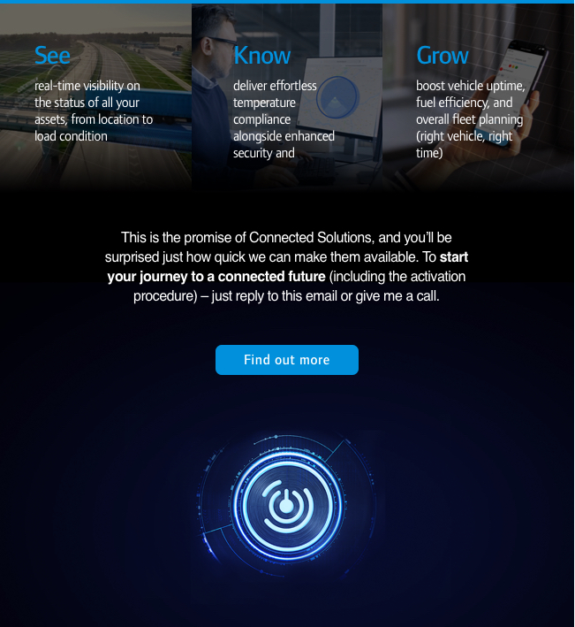
3 ADVANTAGES OF DATA-DRIVEN FLEET OPERATIONS
SEE
With real-time visibility into
the whereabouts
and status of
every asset out on the road.
Reefer status
Load condition
Asset location
KNOW
Rely on effortless compliance
and increased security,
wherever your fleet is headed.
Temperature compliance
Asset security
Cargo traceability
GROW
Contribute to your business
success with increased utilization
and lower costs.
Vehicle uptime
Fuel usage
Intelligent planning
© Thermo King 2019. Strictly confidential.

Slide 5
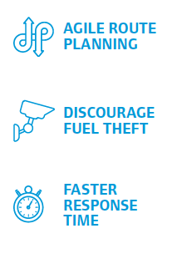
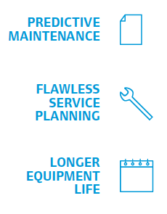
OPTIMIZING VEHICLE UPTIME and fleet performance
Optimize vehicle uptime
All information is available in real-time on Thermo King TracKing platform.
Get warnings of upcoming problems and monitor usage and performance.
Boost uptime and increase life expenctancy of the equipment.
Optimize fleet performance
Become more responsive.
Know immediately when a problem occurs and gain visibility to initiate an effective response.
Think alternative route planning, implement more effective driver trainings and detecting instances of fuel loss.

Slide 6

WIDE RANGE OF APPLICATIONS
Up to 80% fuel savings
Extended to your trailers (Trailer Assist)
Speed up your response time
Available to all (TK BlueBox is factory fitted in all TK SLXi and A-Series units and available as an option for truck units)
Cover all your bases
Instant notifications (TK Notify)
Lean fleet management
Prepration is key
© Thermo King 2019. Strictly confidential.

Slide 7

STAY ON TRACK WITH TRACKING
Thermo King’s TracKing is an innovative, easy to use GPRS/GPS system that gives perishable goods transporters visibility of their assets from their desktops. Having real time temperature, location and alarms information on their refrigerated fleets increases their operational efficiency and reduces incidences of cargo loss. TracKing allows them to guarantee product integrity and on-time delivery to customers.
Cargo protection: maintain high cargo safety standards and ensure on-time delivery
Asset uptime: eliminate unscheduled breakdowns and improve maintenance
Fuel management: save on annual fuel costs with real-time unit usage and cargo visibility
Asset security: be assured that your unit is safe and being used properly
© Thermo King 2019. Strictly confidential.

Slide 8
CONNECTIVITY HARDWARE
BlueBox: telematics device to monitor refrigerated units.
Touchprint Printer: printer for all vehicles
Touchlog: independent temperature monitoring data logger

Slide 9


THANK YOU FOR YOUR ATTENTION!
© Thermo King 2017. Strictly confidential.

Slide 10

We appreciate comments , feedback, and any material useful to enrich our presentation.
E-mail us at:
marketing.europe@thermoking.com

