Slide 1
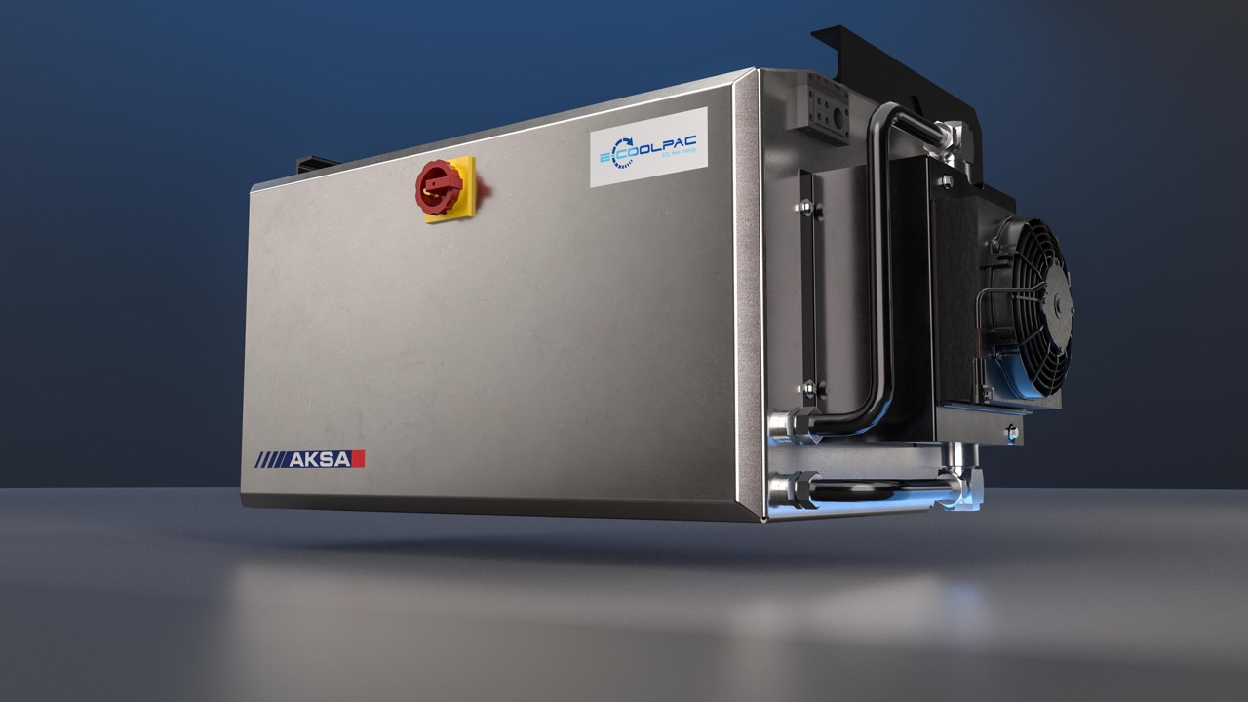

E-COOLPAC Modular battery solution for Truck, Trailer & Marine In partnership with AKSA

Slide 2
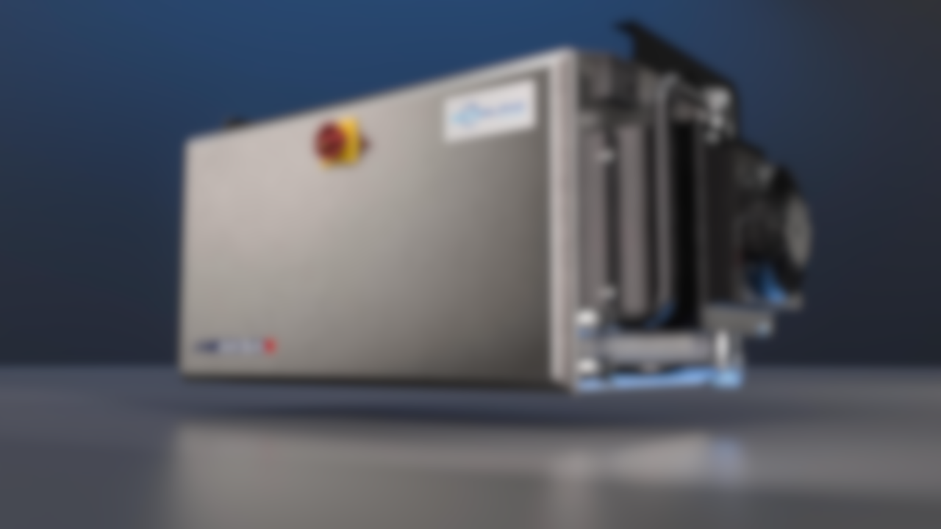
E-COOLPAC Compact, powerful, reliable. The modular battery solution for guaranteed power.
E-COOLPAC

Slide 3
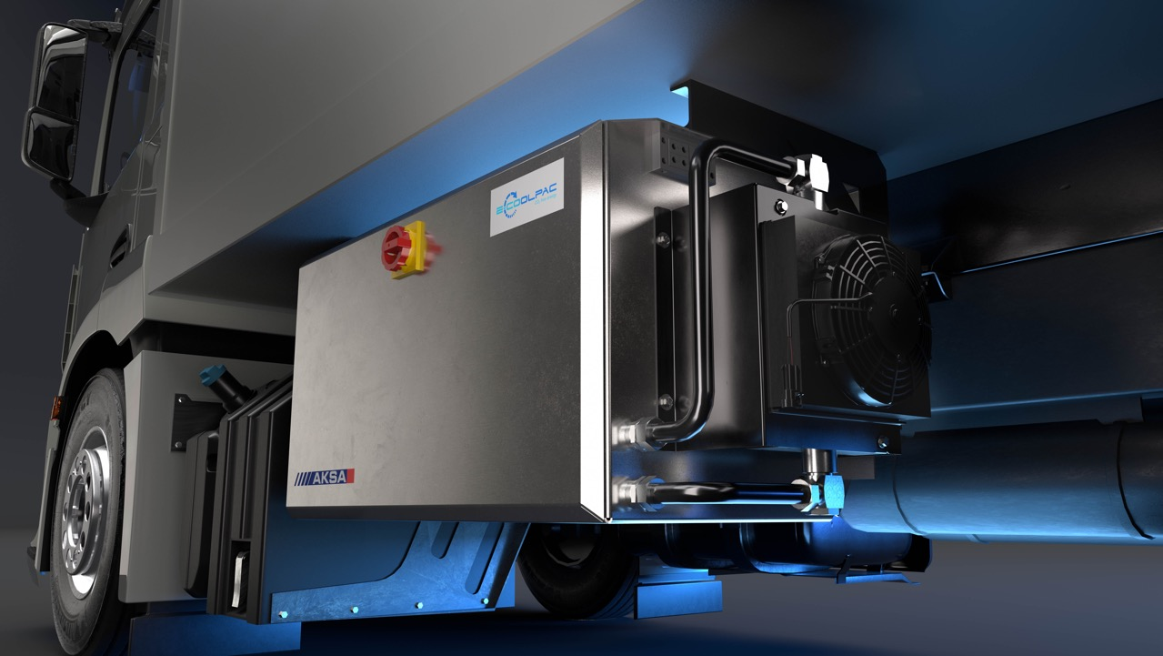


E-COOLPAC
100% EMISSION FREE AND CO₂ NEUTRAL
Boosts your efforts to reach your sustainability goals and gives you access to ultra-low and zero emission zones.
LOW NOISE
Quiet operation ensures day and night access to city centers (PIEK areas).

Slide 4


E-COOLPAC
LONGER REFRIGERATION
More power means longer refrigeration times.
PERMANENT BACK-UP
Sufficient battery capacity to ensure cooling at any time.
FAST, LOW-COST CHARGING
Quick charging on grid power thanks to its powerful 22 kW on-board charger, using a standard CEE 32A 400 V AC 3-Phase 50/60Hz plug or an IEC 61851 compliant mode 2 cable.

Slide 5

E-COOLPAC
MORE UPTIME
State-of-the-art lithium-ion technology and innovative power electronics mean less maintenance through its long lifecycle, resulting in more uptime.
SMART MODULAR DESIGN
A low initial cost combined with
a modular design empower you to future-proof your investment, delivering an attractive ROI and cost savings in the medium term.

Slide 6


E-COOLPAC
SAFETY
Designed to comply with
applicable regulations and standards.
COST SAVING
With E-COOLPAC as a full permanent back-up, you reduce the chance of spoilt loads. Electrifying your unit can save you €5-10K of fuel per vehicle per annum.

Slide 7
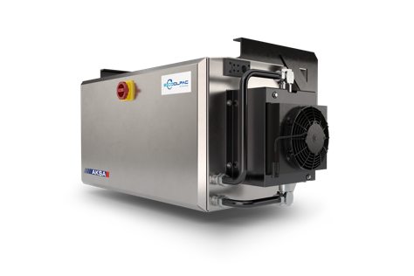
Innovation and sustainability
E-COOLPAC
Onboard battery storage to electrify refrigeration unit
Trailer
VP truck
SP truck
Frigoblock
Marine
Features
Remove diesel engine
No fuel consumption
Lower maintenance cost
Lower noise
Weight neutral
CO₂ reduction
Compatible with:
All trailer, truck & container chassis (also as retrofit)
Diesel, gas, alternative fuel, hybrid and electric trucks
Access to:
Day & night access to city centers
Ultra-low & zero emission zones
Diesel ban areas
Low noise (PIEK) areas

Slide 8
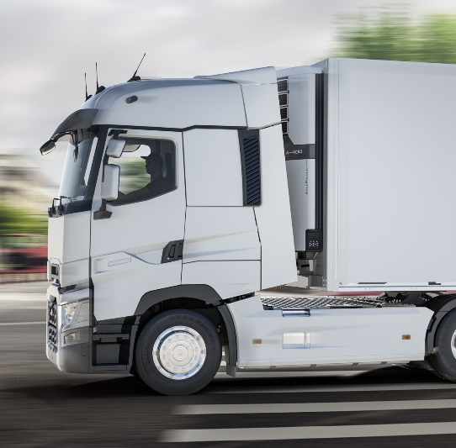
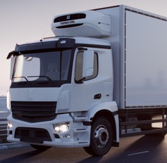
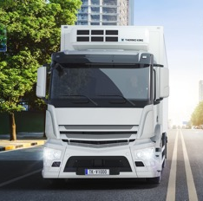
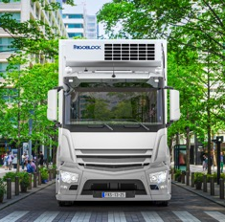
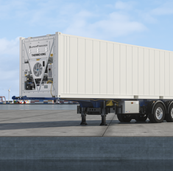
Customer segments
E-COOLPAC
TRAILER
Full electric unit
Hybrid unit
SP TRUCK
Full electric unit
Hybrid unit
VP TRUCK
Full electric unit
Hybrid unit
FRIGOBLOCK
Full electric unit
Hybrid unit
MARINE
Full electric unit

Slide 9
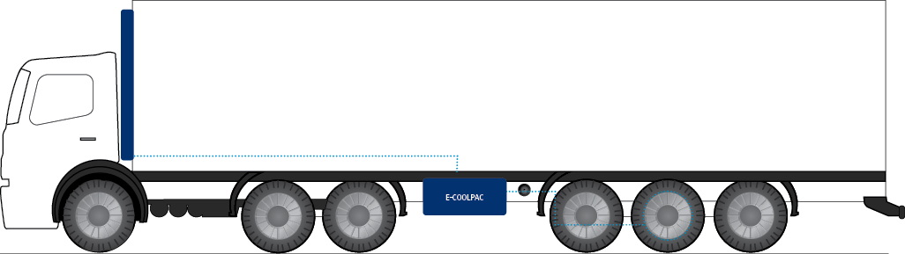
Full electric unit
E-COOLPAC
TRAILER
The E-COOLPAC delivers an AC output and powers the refrigeration unit on stand-by mode.
The E-COOLPAC is charged by grid power.

Slide 10
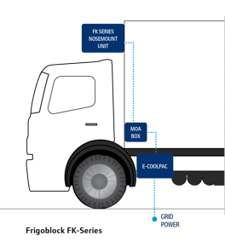
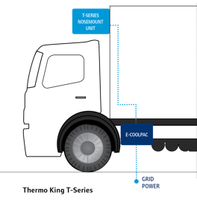
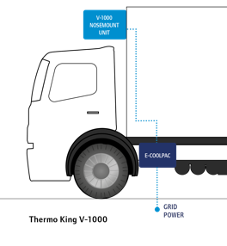
Full electric unit
E-COOLPAC
SP TRUCK
VP TRUCK
FRIGOBLOCK
Full electric solution <10 kW refrigeration
Diesel engine back-up (if battery empty)
Full electric solution <10 kW refrigeration
Lightest solution
Full electric unit >10 kW refrigeration
Most powerful & efficient solution

Slide 11
Hybrid unit
E-COOLPAC
TRAILER
The E-COOLPAC delivers an AC output and powers the refrigeration unit on stand-by mode.
The E-COOLPAC is charged by grid power.
Diesel engine (outside city) + Battery pack (inside city)
Hybrid trailers

Slide 12
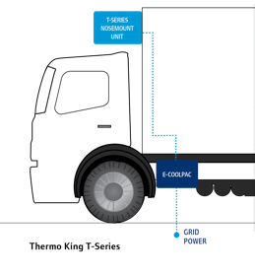
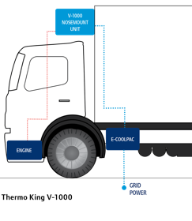
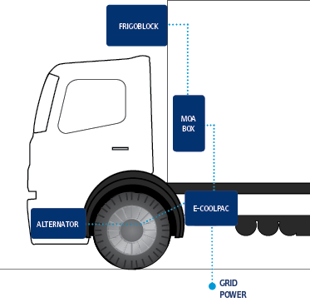

Hybrid unit
E-COOLPAC
SP TRUCK
VP TRUCK
FRIGOBLOCK
Diesel engine (outside city) + Battery pack (inside city)
Hybrid Trucks
Vehicle road compressor (truck drive) + Battery pack (hold-over deliveries, engine off)
No need for truck idling
Alternator power (truck drive) + Battery pack (hold-over deliveries, engine off)
No need for truck idling, alternator recharge battery

Slide 13
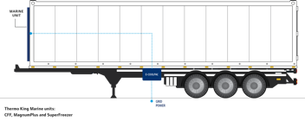
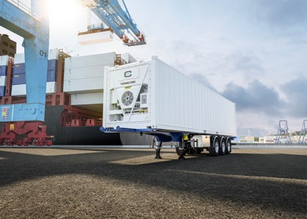
Battery GenSet for marine containers
E-COOLPAC
APPLICATION
Zero emission Marine Container transport in regulated areas
Compatible with Thermo King CFF, Magnum Plus, and Super Freezer units, as well as other ISO1496-2 reefer units
Lower cost of ownership, using green electricity
IDEAL FOR
Port to Port Container transport
Port to Depot Container transport
EASY TO FIT
Smaller and lower weight than diesel genset
Compatible in any container chassis which currently can fit a diesel genset
COMPATIBLE
Fits on EU Flexi Chassis
Fits on EU Skeleton Chassis (both options possible: side & center mount)

Slide 14





E-COOLPAC
HIGHLY MODULAR
control and storage system with simple electrical and mechanical interfaces.
PLUG & PLAY
installation with all required components included.
EASY TO CUSTOMIZE
and configure (capacity); platform independent.
STATE OF CHARGE
accuracy allows better control over autonomy.
Most extensive offering in market 15 kWh, 20 kWh, 25 kWh, 35 kWh, 70 kWh and 105 kWh to suit all customer needs

Slide 15






Choose the charging method that suits you
E-COOLPAC
E-COOLPAC CAN BE CHARGED OPTIONALLY ON TRUCK DRIVE VIA THE AW FRIGOBLOCK ALTERNATOR OR STANDARD AS FOLLOWS:
MODE 2
ICCB CABLE WITH CEE PLUG
CEE CONNECTOR
32 AMP
MODE 3
TYPE 2 CABLE WITH TYPE 2 PLUG
CHARGING
STATION
Most extensive offering in market 15 kWh, 20 kWh, 25 kWh, 35 kWh, 70 kWh and 105 kWh to suit all customer needs

Slide 16







E-COOLPAC
Key take-aways
INDEPENDENT SYSTEM
MODULAR SYSTEM
PURPOSE BUILT FOR TRANSPORT
SAFETY
PERMANENT BACK-UP
RAPID CHARGING
Key take-aways
INDEPENDENT SYSTEM
MODULAR SYSTEM
PURPOSE BUILT FOR TRANSPORT
SAFETY
PERMANENT BACK-UP
RAPID CHARGING

Slide 17
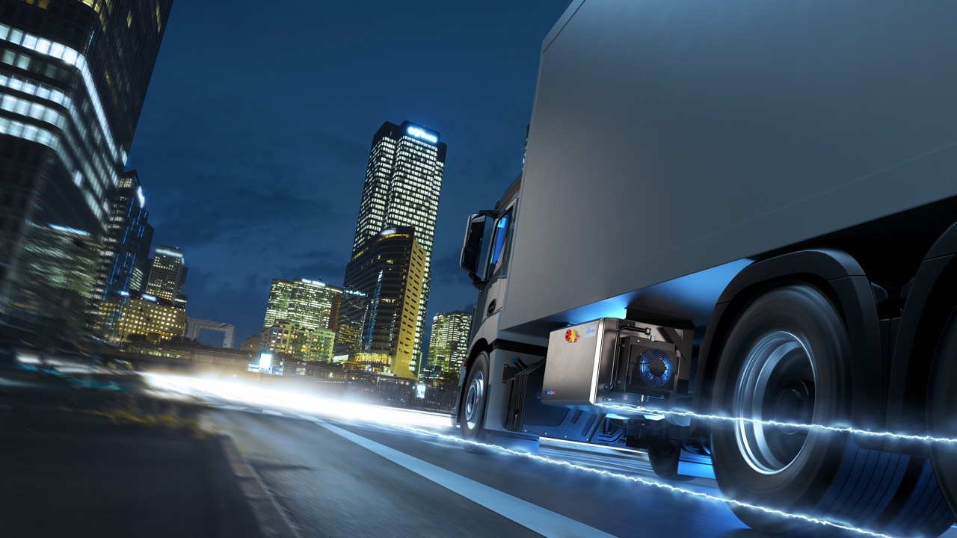
E-COOLPAC
THANK YOU
Key take-aways
INDEPENDENT SYSTEM
MODULAR SYSTEM
PURPOSE BUILT FOR TRANSPORT
SAFETY
PERMANENT BACK-UP
RAPID CHARGING

Slide 18


We appreciate comments , feedback, and any material useful to enrich our presentation.
E-mail us at:
marketing.europe@thermoking.com

