Slide 1


V-series – Temperature control for Vans and Small Trucks

Slide 2
Table of Contents
V-SERIES: INTRODUCTION
DIRECT SMART REEFER (DSR) CONTROLLER
R-452A: THE PLANET’S BEST CHOICE
FEATURES & OPTIONS
UNIT SELECTION GUIDE
FEATURES & OPTIONS
CONFIGURATION OVERVIEW
SINGLE-TEMPERATURE MODELS SPECIFICATIONS
MULTI-TEMPERATURE MODELS SPECIFICATIONS
DIMENSIONS
WEIGHTS
© Thermo King 2019. Strictly confidential.

Slide 3

V-SERIES: INTRODUCTION
SUPERIOR NON DIESEL TEMPERATURE CONTROL FOR VANS AND SMALL TRUCKS
Flexible, powerful, dependable
R-452A as standard
Low noise and zero exhaust emissions
Cost-effective service and maintenance
Easy installation
User-friendly Direct Smart Reefer
Low operating costs
© Thermo King 2019. Strictly confidential.

Slide 4
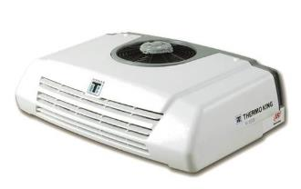
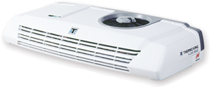
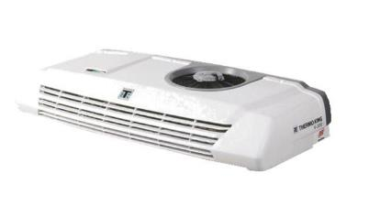
V-SERIES: INTRODUCTION
V-100/200s, V-200 AND V-300 SERIES:
Optimal temperature control solution for trucks and vans up to 28 m³
Modern compact platform
Small but powerful
Low noise and low emission
User-friendly Direct Smart Reefer
Flexibility
Spectrum models for multi temperature applications
Improved reliability
Enhanced heating performance
V-100 / V-200s
V-200 Spectrum/ V-300 Spectrum
V-200 / V-300
© Thermo King 2019. Strictly confidential.

Slide 5
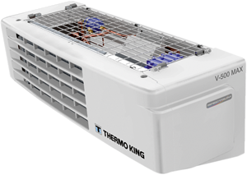
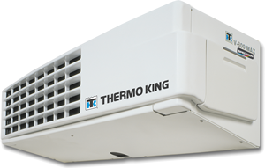
V-SERIES: INTRODUCTION
V-500, V-600 AND V-800 SERIES:
Optimal temperature control solution for trucks up to 54 m³
Low noise for urban distribution
Low environmental impact
Exceptional cooling performance on the road and in standby
Spectrum models for multi temperature applications
Enhanced heating capacity
High efficiency
User-friendly Direct Smart Reefer
V-500 / V-500 MAX
V-600 MAX / V-500 MAX Spectrum
V-800 / V-800 MAX / V-800 MAX Spectrum
© Thermo King 2019. Strictly confidential.

Slide 6
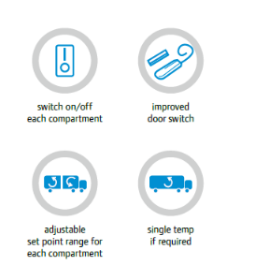
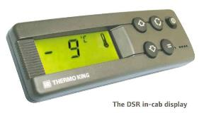
DIRECT SMART REEFER (DSR) CONTROLLER
DSR IN-CAB DISPLAY
LCD technology with LED backlighting
Multiple functions: transport applications, optimal temperature control & product integrity
Malfunction? Easily interpreted alarm code, rapid and appropriate remedial action
DSR CONTROL BOARD
A modular concept that separates control and power relay boards
Improved reliability, serviceability and component replacement
Lower service and maintenance costs
FEATURES
Standard features
Programmable features
Multi-temperature features
© Thermo King 2019. Strictly confidential.

Slide 7


R-452A REFRIGERANT: THE PLANET’S BEST CHOICE
THE GREENEST REFRIGERANT ON THE MARKET STANDARD ON TRAILER, TRUCK AND DIRECT DRIVE UNITS
Pre-emptive compliance with 2020 F-Gas regulations
Positive environmental impact increased by 45%
Easy conversion of older fleet
Load protection is ensured
Fuel consumption is unaffected
Full cooling capacity is maintained

Slide 8

FEATURES & OPTIONS
THERMOKARE
Complete selection of service contact solutions
Manage maintenance costs and hence total life cost of a unit
TOUCHPRINT DATA CARE
User-friendly temperature recorders
Delivery and journey printouts at the touch of a button
Approved to EN 12830, CE Mark and IP-65 standards
WINTRAC™ (DATA ANALYSIS SOFTWARE)
User-friendly software compatible with DSR controller for configuration file downloads
USB DATA LOGGER
Humidity, temperature and dew point recorder
DATALOGGER JR
Programmable temperature recorder
DOOR SWITCHES
Reduce load temperature rise and save fuel when doors are opened
© Thermo King 2019. Strictly confidential.

Slide 9

FEATURES & OPTIONS
DIN ADAPTER
Permits the adaption of the DSR controller to the vehicle dashboard
Allows the placement of the DSR controller in any available radio slot compartment in the driver cab
MUFFLER KIT
Eliminates the vibrations and noise in the cabin
Enhancing user comfort
SNOW COVERS
Protect your unit against extreme climate conditions
Prevents the buildup of snow and ice on the units fans
HOSE COVERS
Full protection of hoses and cables on the road
Full resistance under all climate adversities
Designed with best aesthetics to promote brand image and with an exceptional durability
User-friendly installation (only for chassis installations, no vans)
HARNESS EXTENSION
The 2, 4 or 6 m harness extension allows evaporators to be located to suit any customer’s needs
Extremely easy installation (plug-and-play connection)
Full flexibility to position the evaporators especially in multi-temp applications
HOSE EXTENSION
The 2, 4 or 6 meter hose extensions (includes corresponding splice connectors) are also on offer as option for remote evaporators
© Thermo King 2019. Strictly confidential.

Slide 10
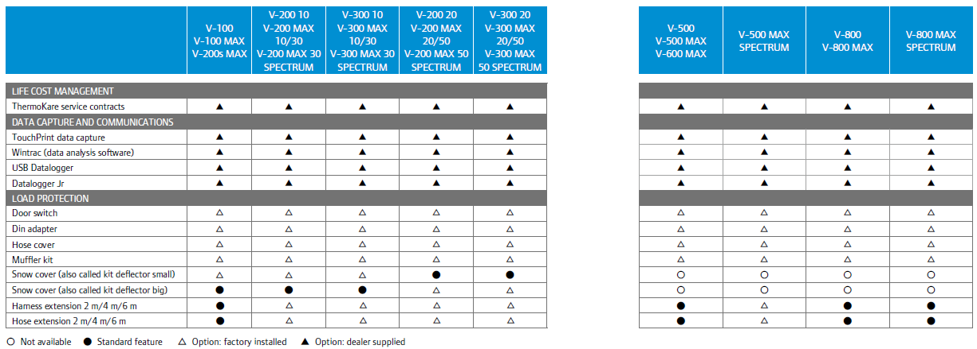
FEATURES & OPTIONS
© Thermo King 2019. Strictly confidential.

Slide 11
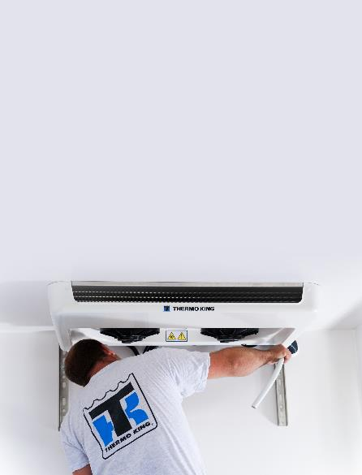
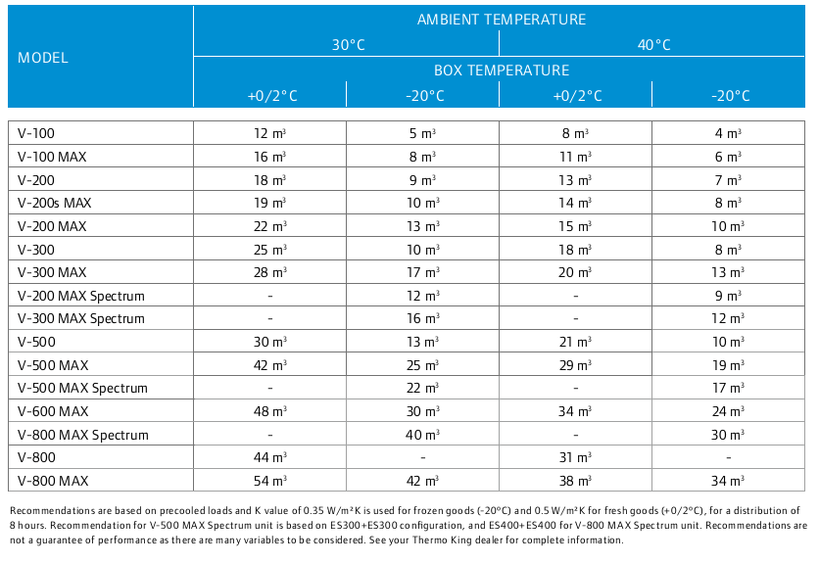
UNIT SELECTION GUIDE
© Thermo King 2019. Strictly confidential.

Slide 12
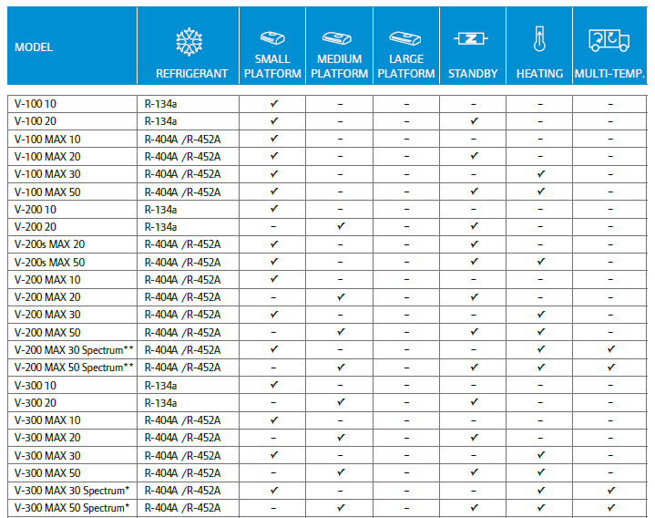

CONFIGURATION OVERVIEW
© Thermo King 2019. Strictly confidential.

Slide 13

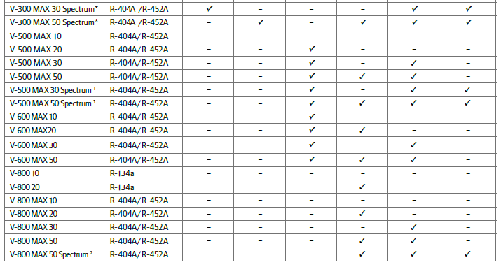
CONFIGURATION OVERVIEW
© Thermo King 2019. Strictly confidential.

Slide 14
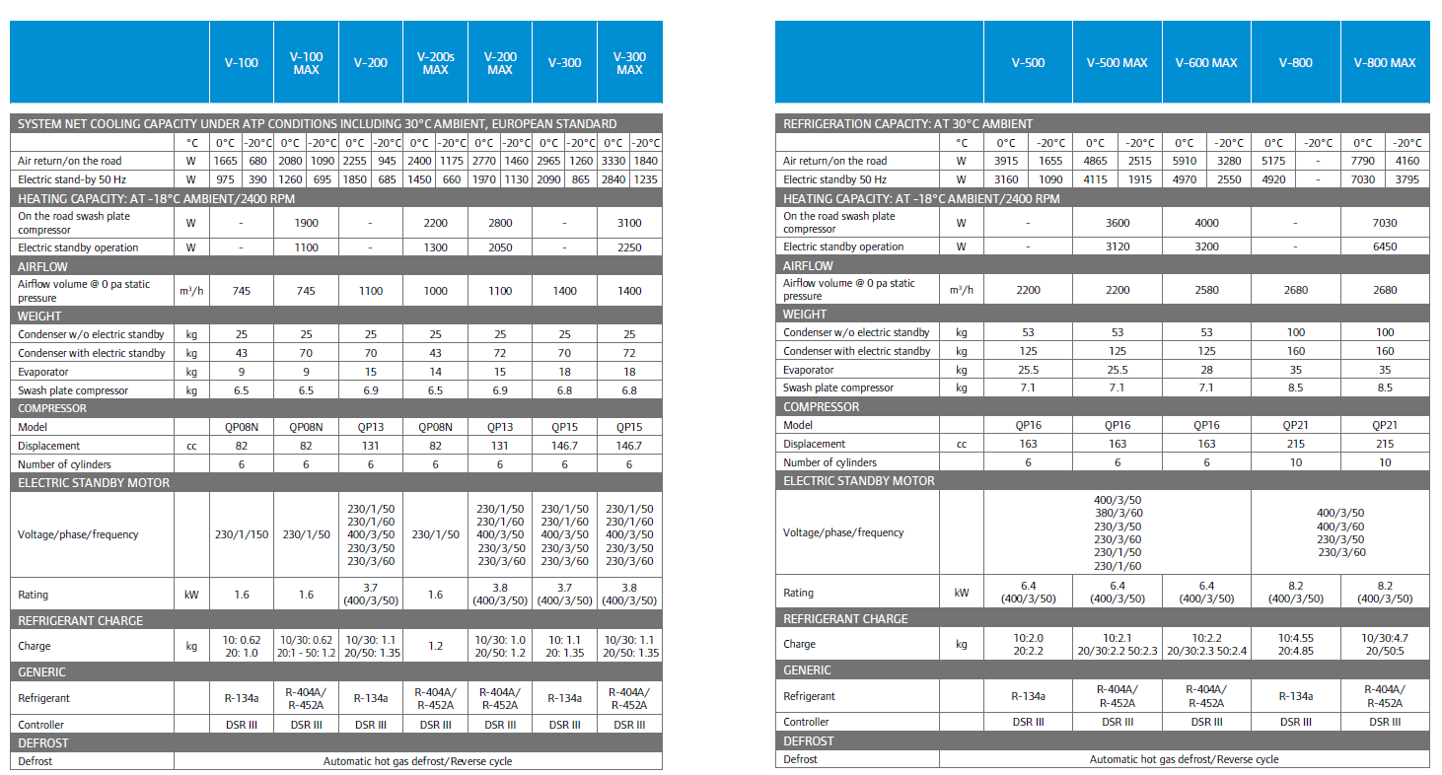

single-temperature models specifications
© Thermo King 2019. Strictly confidential.

Slide 15
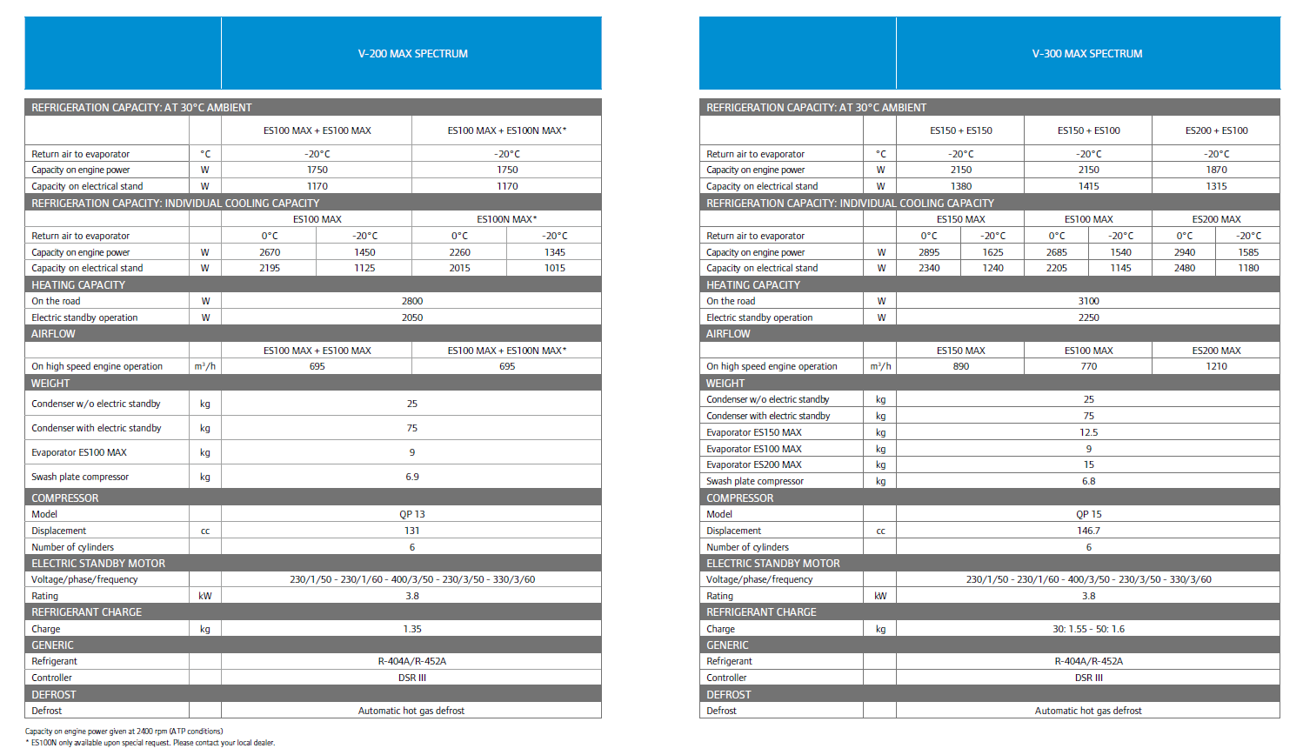
MULTI-TEMPERATURE models specifications
2
YEAR WARRANTY
Thermo King warrants the new product delivered will be free of defects in material and workmanship for the period of time specified in the applicable warranties. Specific terms of the Thermo King warranty are available on request.
2
© Thermo King 2019. Strictly confidential.

Slide 16
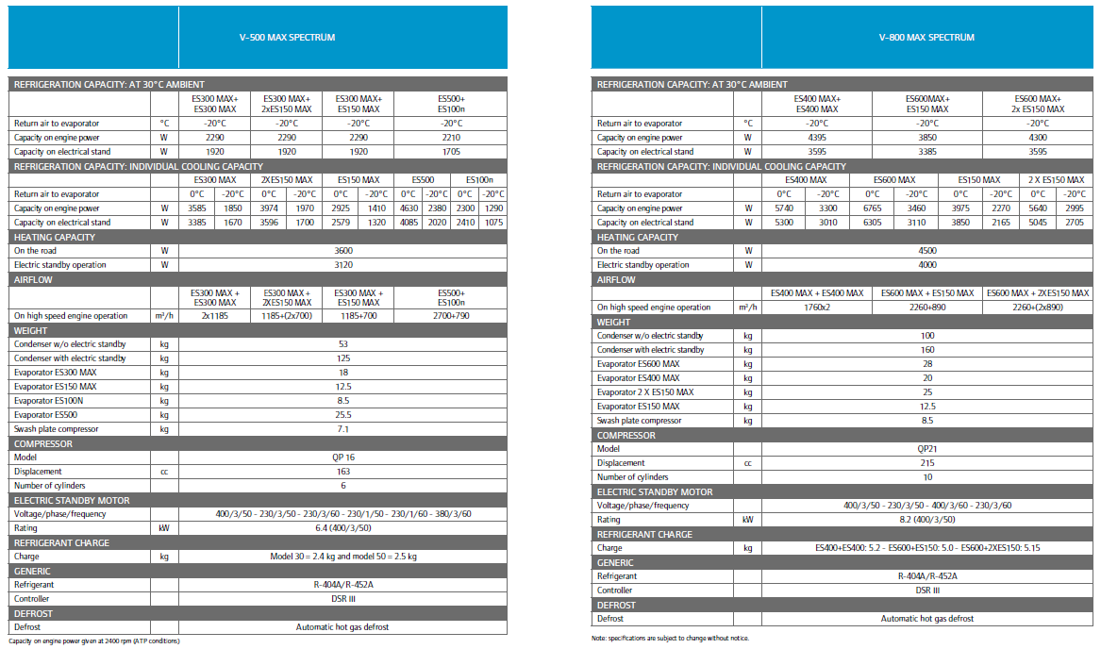
MULTI-TEMPERATURE models specifications
© Thermo King 2019. Strictly confidential.

Slide 17
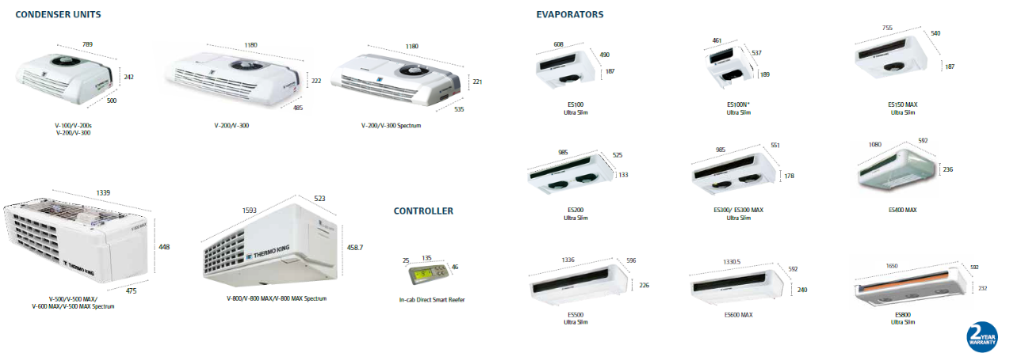
DIMENSIONS (mm)
© Thermo King 2019. Strictly confidential.

Slide 18
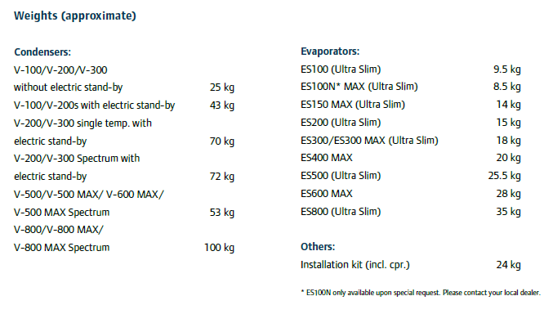
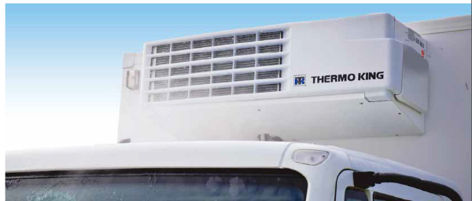
WEIGHTS
© Thermo King 2019. Strictly confidential.

Slide 19
THANK YOU FOR YOUR ATTENTION!
V- SERIES
Superior Temperature Control
for Small Trucks And vans
© Thermo King 2019. Strictly confidential.

Slide 20

We appreciate comments , feedback, and any material useful to enrich our presentation.
E-mail us at:
marketing.europe@thermoking.com

