Slide 1

SINGLE AND MULTI-TEMPERATURE SELF-POWERED REFRIGERATION SYSTEMS FOR UNDERMOUNT APPLICATIONS

Slide 2
Contents
UT-Series
Benefits
Facts and figures
Applications
Specifications
Dimensions

Slide 3
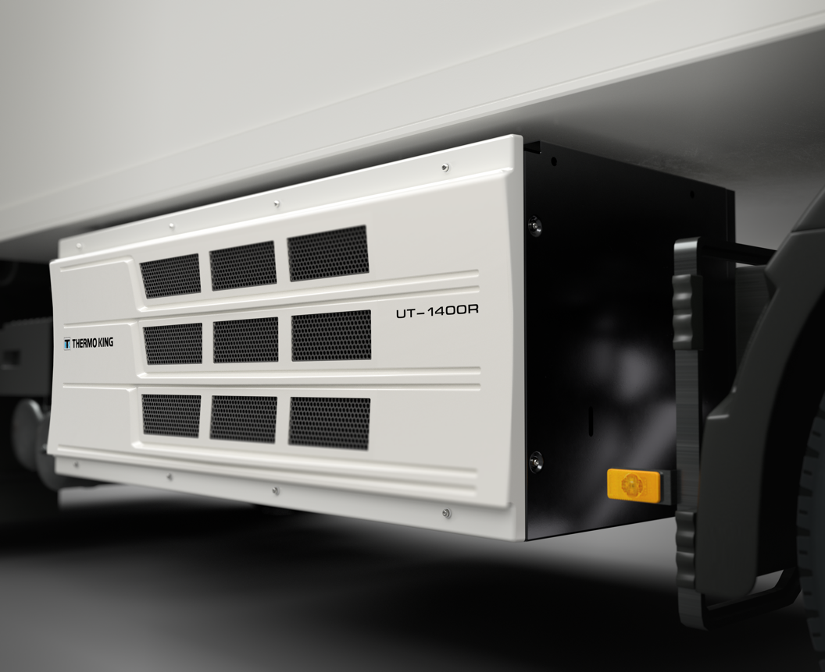
Go undermount
WHY UT-SERIES?
Advantages of undermount refrigeration
Lower truck height for better access to the city
Higher truck cabin and lower noise for more driver comfort
Lower center of gravity and less weight on front axle for better truck balance
Better access for service/maintenance (no work at heights)
Common applications
Inner city distribution
City-to-city distribution (long haul or city trailers)
Pharma distribution
Airport catering
Notes:
Our dedication to your fleet’s success extends far beyond your refrigeration unit. For every outcome you’re pursuing, we offer an extensive portfolio of smart services and solutions with a digital-first approach. From uptime and sustainability to savings and control, we can offer you a customized solution to enhance the performance of your refrigeration unit. In other words, we help you to Max Your Cool.
Digital first approach: Responding swiftly and making data-driven decisions is crucial in today's integrated cold chain. With better-connected units, vehicles, and workshops, you will enhance both visibility and remote control capabilities through the power of data. From wireless systems to industry-leading telematics and user-friendly dashboards: Thermo King puts digital on top, and smarter operations at your fingertips.

Slide 4
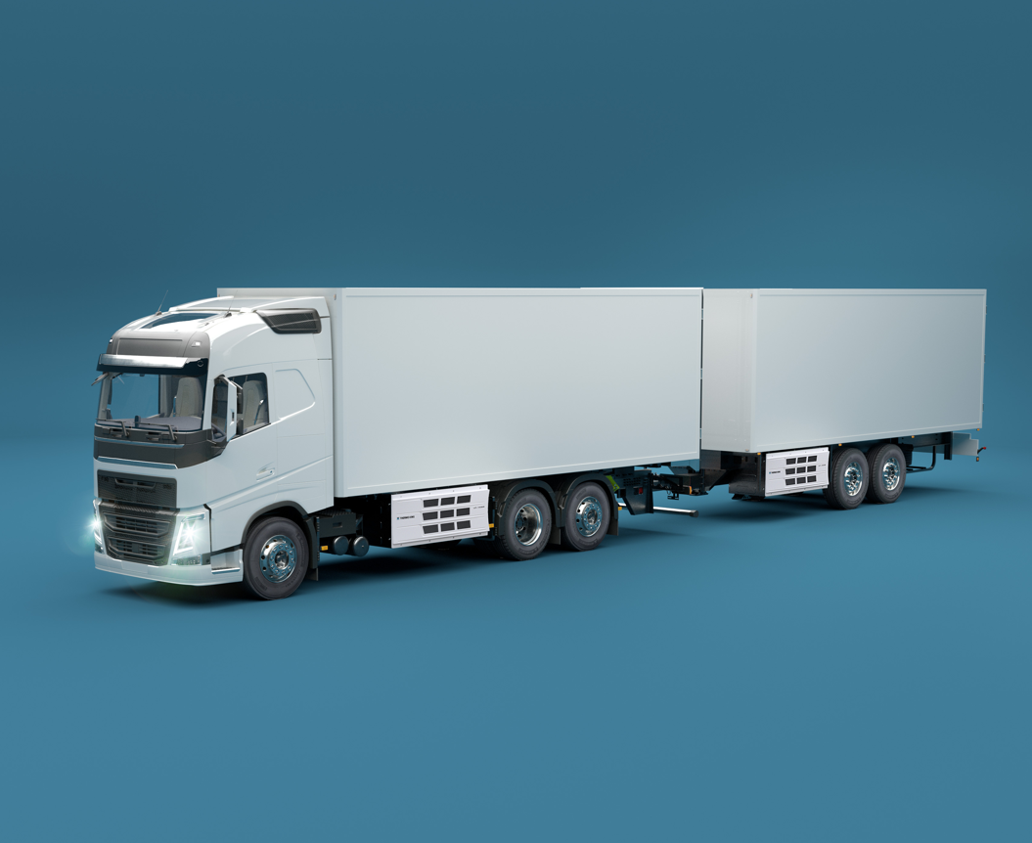
Quiet power
BENEFITS
Optimized uptime and cargo safety
The highest cooling capacity in the diesel undermount market allows for a much quicker time to reach the set-point and recover temperature after door openings
UT-R Spectrum enables multi-temperature flexibility for delivering fresh and frozen good with up to three different compartments
Quiet operations, day & night
Reduced noise and vibrations by 3dB(A) versus the legacy product
Lower noise improves the perception of your operations on your local community and the well-being of your drivers
Emitted noise can be further reduced with Whisper option on all models, up to 4dB(A)
Notes:
Our dedication to your fleet’s success extends far beyond your refrigeration unit. For every outcome you’re pursuing, we offer an extensive portfolio of smart services and solutions with a digital-first approach. From uptime and sustainability to savings and control, we can offer you a customized solution to enhance the performance of your refrigeration unit. In other words, we help you to Max Your Cool.
Digital first approach: Responding swiftly and making data-driven decisions is crucial in today's integrated cold chain. With better-connected units, vehicles, and workshops, you will enhance both visibility and remote control capabilities through the power of data. From wireless systems to industry-leading telematics and user-friendly dashboards: Thermo King puts digital on top, and smarter operations at your fingertips.

Slide 5
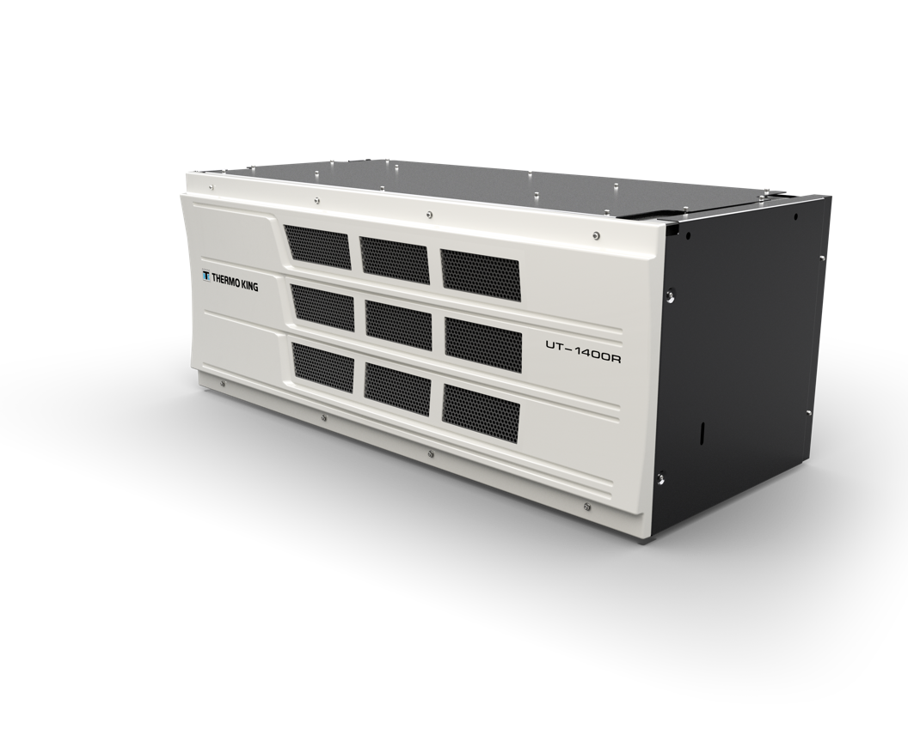
Small & strong
BENEFITS
More time on the road
Built upon the legacy of Thermo King’s T-Series, class leader in reliability
Thermo King’s best-in-class compressor and new enclosure design dramatically reduce the risk of breakdown and makes the unit much easier to service
2 Years warranty as standard, and 3 or 4 years extended warranty as an option for additional peace of mind
Compact and light-weight
More space available underneath the truck thanks to a 200mm width and 10% volume reduction versus the legacy product
40 kg weight reduction versus the legacy product for increased cargo payload
Notes:
Our dedication to your fleet’s success extends far beyond your refrigeration unit. For every outcome you’re pursuing, we offer an extensive portfolio of smart services and solutions with a digital-first approach. From uptime and sustainability to savings and control, we can offer you a customized solution to enhance the performance of your refrigeration unit. In other words, we help you to Max Your Cool.
Digital first approach: Responding swiftly and making data-driven decisions is crucial in today's integrated cold chain. With better-connected units, vehicles, and workshops, you will enhance both visibility and remote control capabilities through the power of data. From wireless systems to industry-leading telematics and user-friendly dashboards: Thermo King puts digital on top, and smarter operations at your fingertips.

Slide 6
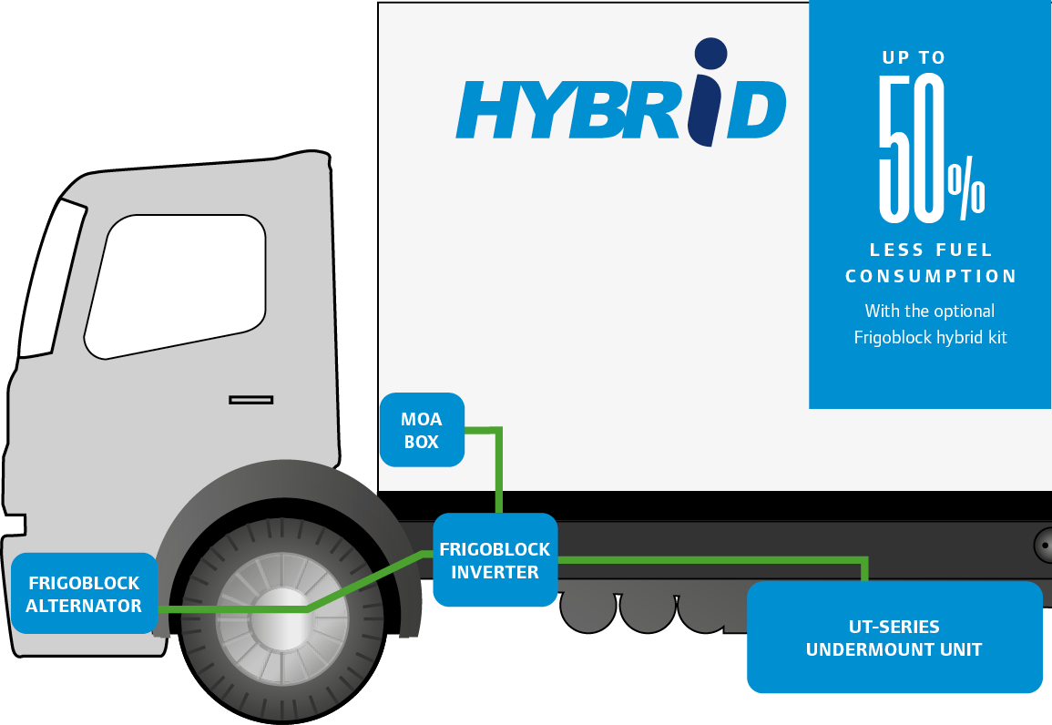
Reduced environmental impact
BENEFITS
Performance & efficiency
Maximum system efficiency by optimizing compressor and engine speed ratio and using the Electronic Throttling Valve (ETV) for an optimized refrigeration system
Industry cleanest GreentechTM engine reduces CO₂ and other pollutant emissions
Smart Cycle-Sentry control mode reduces fuel consumption and emissions by up to 80%
Alternative power sources
Fully compatible with 100% HVO biofuel for up to 90% CO₂ emissions reduction, with no impact on maintenance schedule
Hybrid option available for up to 50% less fuel consumption
Notes:
Our dedication to your fleet’s success extends far beyond your refrigeration unit. For every outcome you’re pursuing, we offer an extensive portfolio of smart services and solutions with a digital-first approach. From uptime and sustainability to savings and control, we can offer you a customized solution to enhance the performance of your refrigeration unit. In other words, we help you to Max Your Cool.
Digital first approach: Responding swiftly and making data-driven decisions is crucial in today's integrated cold chain. With better-connected units, vehicles, and workshops, you will enhance both visibility and remote control capabilities through the power of data. From wireless systems to industry-leading telematics and user-friendly dashboards: Thermo King puts digital on top, and smarter operations at your fingertips.

Slide 7
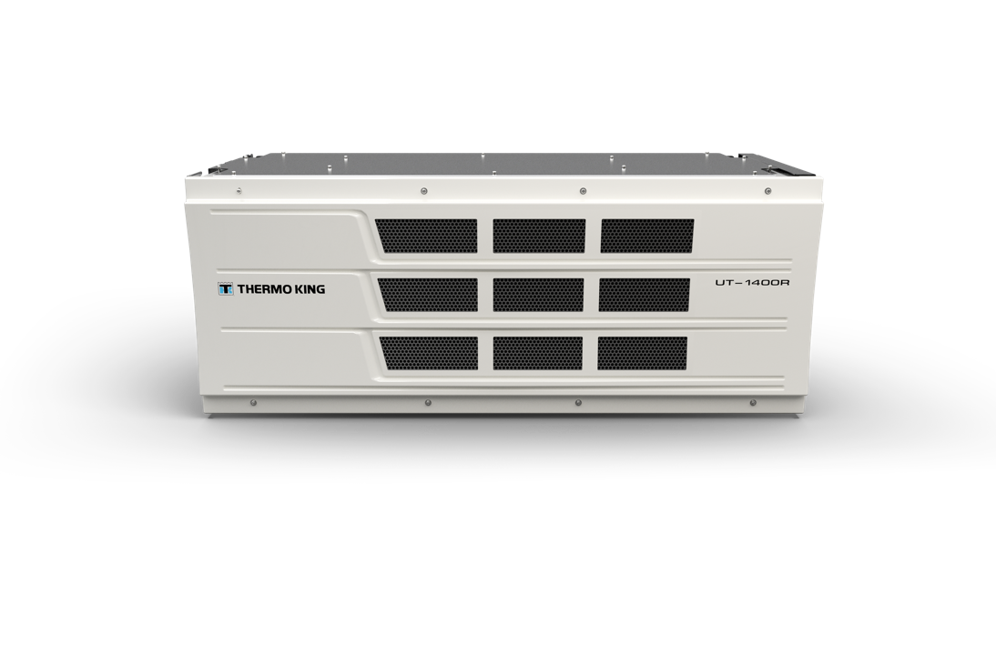
The new UT-SERIES in numbers
FACTS & FIGURES
3dB(A)
40kg
Lighter than legacy product
Quieter than legacy product
18%
UP TO
10%
More powerful and efficient vs next best competitive alternative
Smaller than legacy product

Slide 8
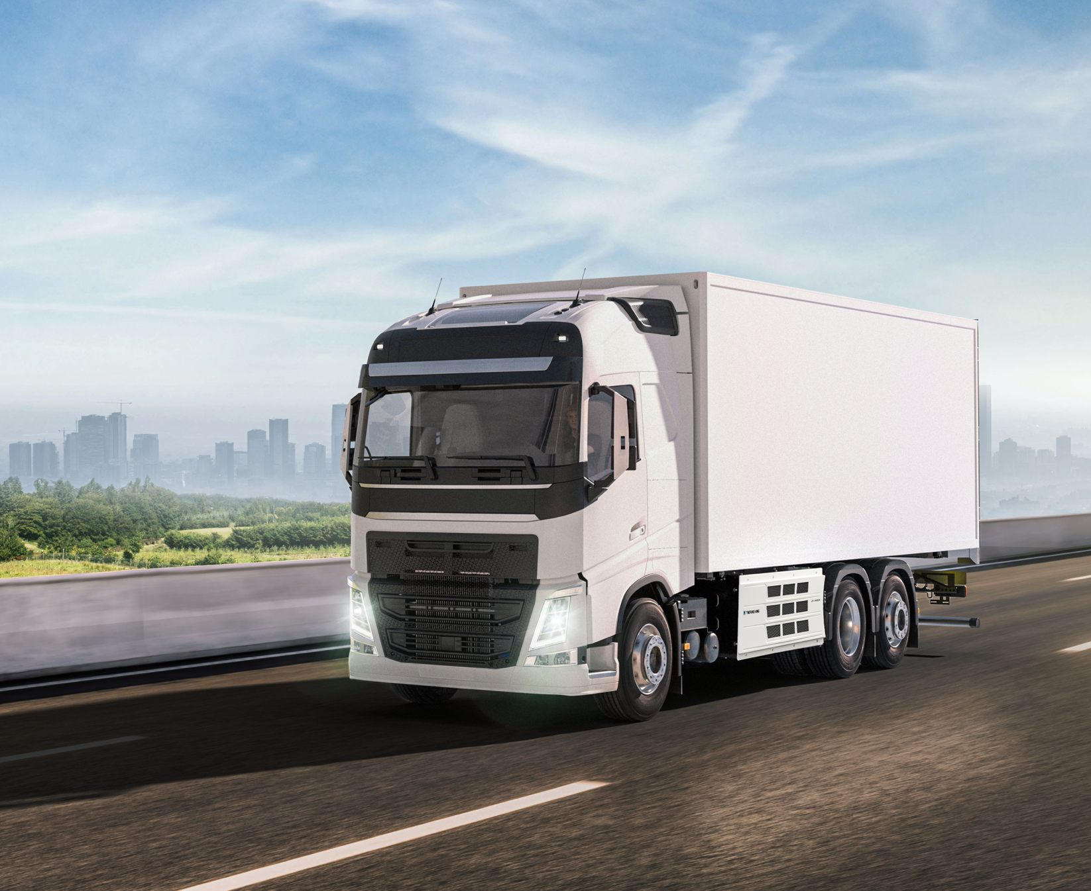
Inner city distribution
APPLICATIONS
Reduced noise and emissions
Better temperature recovery
Lower truck heights and more space available
Recommended options: Whisper kit
Notes:
Our dedication to your fleet’s success extends far beyond your refrigeration unit. For every outcome you’re pursuing, we offer an extensive portfolio of smart services and solutions with a digital-first approach. From uptime and sustainability to savings and control, we can offer you a customized solution to enhance the performance of your refrigeration unit. In other words, we help you to Max Your Cool.
Digital first approach: Responding swiftly and making data-driven decisions is crucial in today's integrated cold chain. With better-connected units, vehicles, and workshops, you will enhance both visibility and remote control capabilities through the power of data. From wireless systems to industry-leading telematics and user-friendly dashboards: Thermo King puts digital on top, and smarter operations at your fingertips.

Slide 9
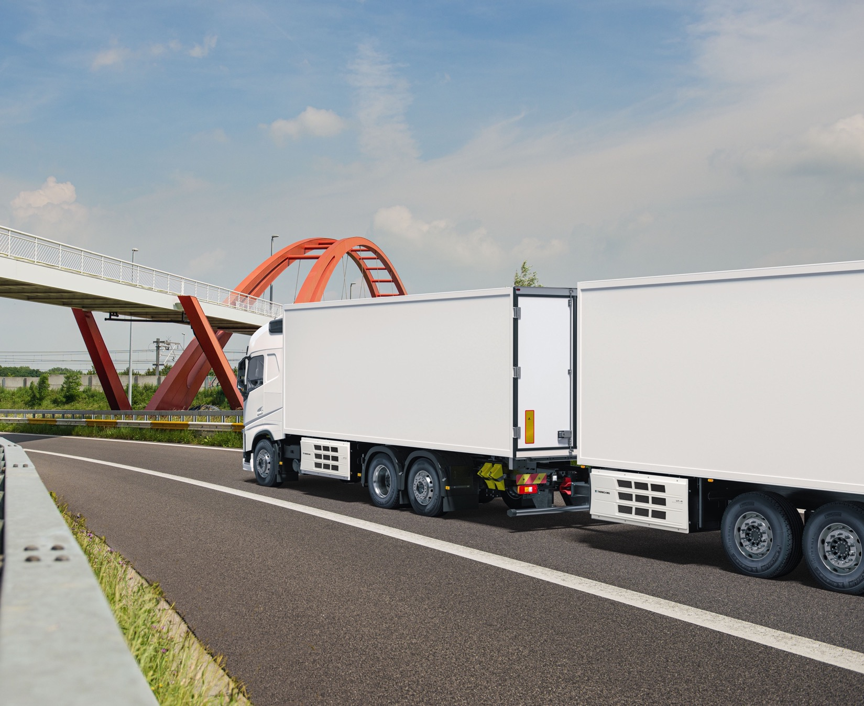
City-to-city distribution
APPLICATIONS
Lower costs of operations
Higher driver retention
Operations reliability
Recommended options: Telematics
Notes:
Our dedication to your fleet’s success extends far beyond your refrigeration unit. For every outcome you’re pursuing, we offer an extensive portfolio of smart services and solutions with a digital-first approach. From uptime and sustainability to savings and control, we can offer you a customized solution to enhance the performance of your refrigeration unit. In other words, we help you to Max Your Cool.
Digital first approach: Responding swiftly and making data-driven decisions is crucial in today's integrated cold chain. With better-connected units, vehicles, and workshops, you will enhance both visibility and remote control capabilities through the power of data. From wireless systems to industry-leading telematics and user-friendly dashboards: Thermo King puts digital on top, and smarter operations at your fingertips.

Slide 10
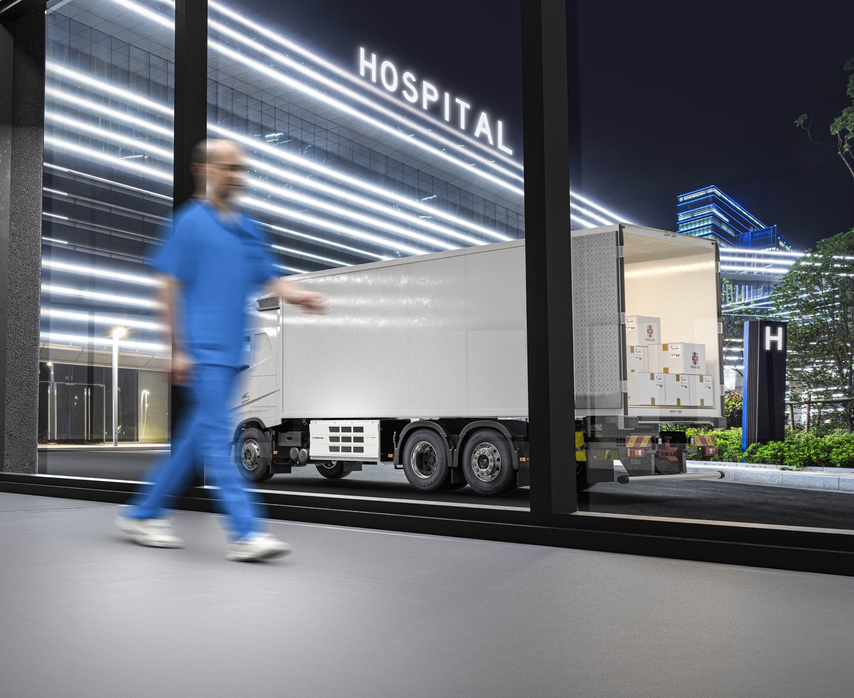
Pharma distribution
APPLICATIONS
Accurate temperature control
Operations reliability
Reduced noise and emissions
Recommended options: Precise Temperature control (PTC)
Notes:
Our dedication to your fleet’s success extends far beyond your refrigeration unit. For every outcome you’re pursuing, we offer an extensive portfolio of smart services and solutions with a digital-first approach. From uptime and sustainability to savings and control, we can offer you a customized solution to enhance the performance of your refrigeration unit. In other words, we help you to Max Your Cool.
Digital first approach: Responding swiftly and making data-driven decisions is crucial in today's integrated cold chain. With better-connected units, vehicles, and workshops, you will enhance both visibility and remote control capabilities through the power of data. From wireless systems to industry-leading telematics and user-friendly dashboards: Thermo King puts digital on top, and smarter operations at your fingertips.

Slide 11
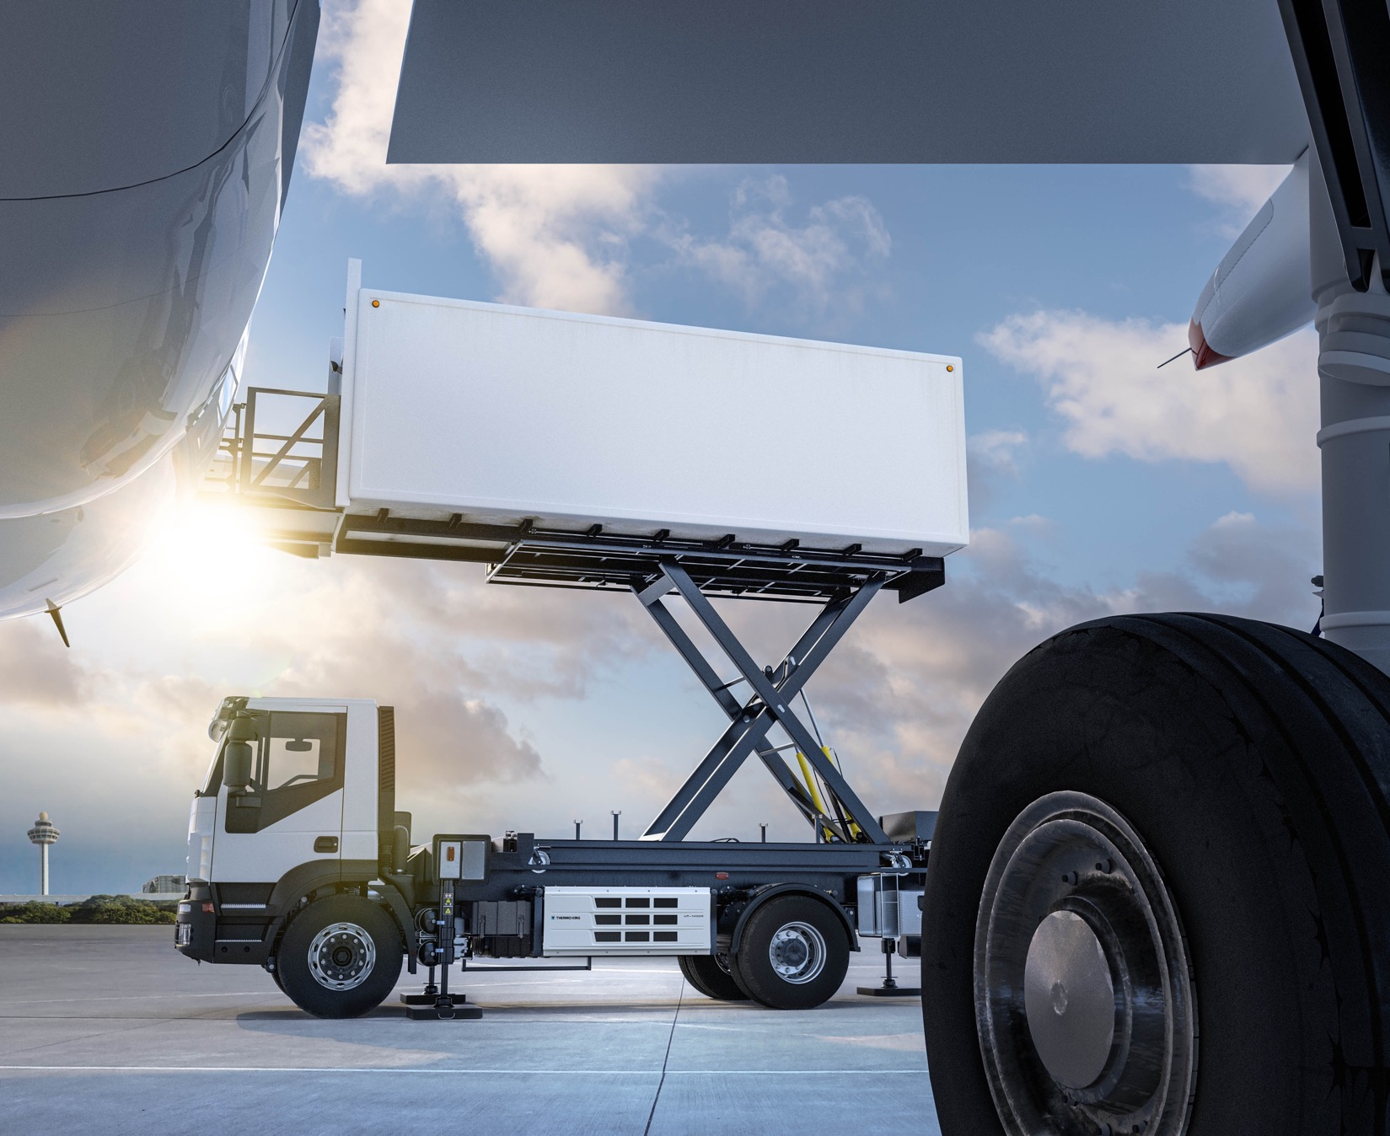
Airport catering
APPLICATIONS
Reduced noise and emissions
Operations reliability
Lower costs of operations
Recommended options: Whisper kit
Notes:
Our dedication to your fleet’s success extends far beyond your refrigeration unit. For every outcome you’re pursuing, we offer an extensive portfolio of smart services and solutions with a digital-first approach. From uptime and sustainability to savings and control, we can offer you a customized solution to enhance the performance of your refrigeration unit. In other words, we help you to Max Your Cool.
Digital first approach: Responding swiftly and making data-driven decisions is crucial in today's integrated cold chain. With better-connected units, vehicles, and workshops, you will enhance both visibility and remote control capabilities through the power of data. From wireless systems to industry-leading telematics and user-friendly dashboards: Thermo King puts digital on top, and smarter operations at your fingertips.

Slide 12
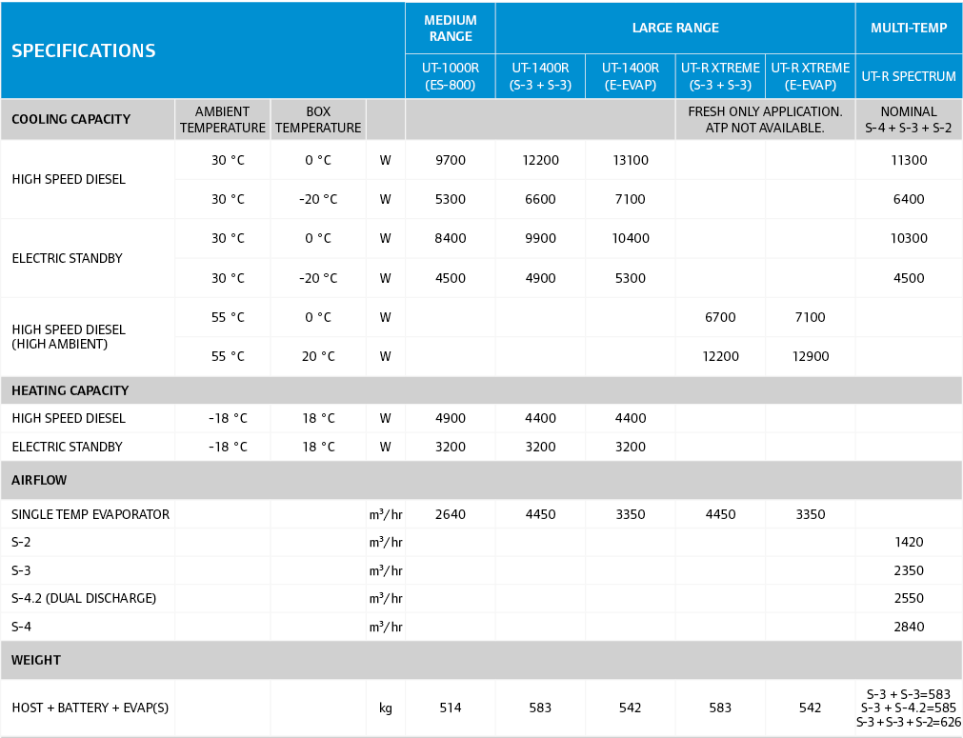
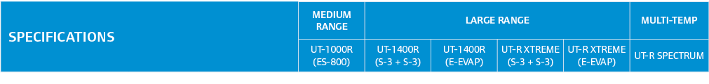
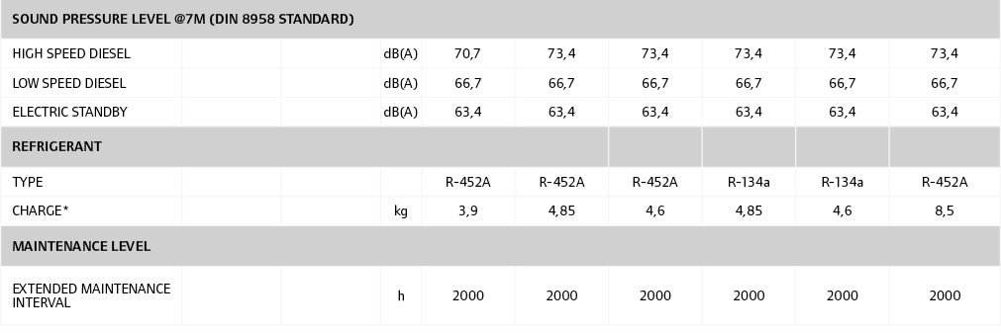
Specifications
SPECIFICATIONS

Slide 13
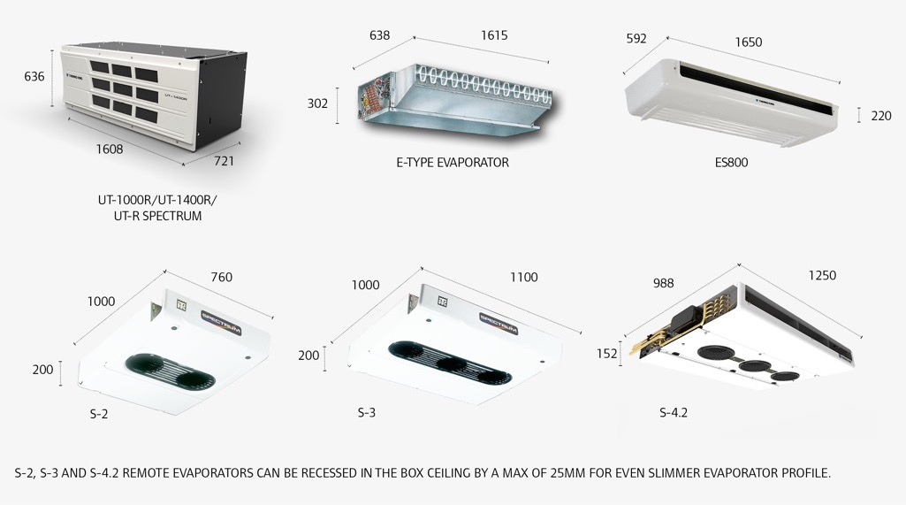
Dimensions
DIMENSIONS

Slide 14
THANK YOU

